Slide 1
Machine Learning
Bianca Furtuna
Technical Evangelist
@Fur_Bi

Slide 2


Slide 3
Descriptive
Predictive
Prescriptive
Intelligent action
What happened?
Why did it happen?
What will happen?
What should I do?

Slide 4
Cortana Intelligence Suite Transform data into intelligent action
Information Management
Big Data Stores
Machine Learning and Analytics
Intelligence
Data Sources
People
Data Factory
Data Lake Store
Machine Learning
Cognitive Services
Data Catalog
SQL Data
Warehouse
Data Lake Analytics
Bot Framework
Web
Apps
HDInsight
(Hadoop and Spark)
Event Hubs
Cortana
Mobile
Apps
Stream Analytics
Bots
Dashboards & Visualizations
Sensors and devices
Power BI
Automated Systems
Data
Intelligence
Action

Slide 5
Machine Learning scenarios
EXAMPLE SOLUTIONS
Sales and marketing
Finance and risk
Customer and channel
Operations and workforce
Customer acquisition
Fraud detection
Lifetime customer value
Pay for performance
Cross-sell and upsell
Credit risk management
Personalized offers
Operational efficiency
Loyalty programs
Product recommendation
Smart buildings
Marketing mix optimization
Predictive maintenance
Supply chain management

Slide 6
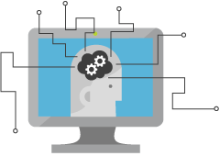
What is Machine Learning?
Computing Systems that become smarter with Experience
Experience = Past Data + Human Input
@Fur_Bi

Slide 7




Why now?
+
+
=

Slide 8
Learning?
Y = aX - b
y = 4.8081x - 56.241
@Fur_Bi

Slide 9
How can Machine Learning bring value?
Machine
Learning
Data
Insights
@Fur_Bi

Slide 10
Questions?
Use maths to answer questions
@Fur_Bi

Slide 11
What type of questions?
Is this class A or class B?
Is this class A or class B or class C or …. class Z?
How much/How many?
Is this anomalous behaviour?
What are the patterns/groupings?
@Fur_Bi

Slide 12
Machine Learning Process
Use case
Data
Prep + Build + Test
Publish
Data Preparation
Evaluation
Modelling

Slide 13
Data
Clients
API
ML STUDIO
Model is now a web service that is callable
Blobs and Tables
Hadoop (HDInsight)
Relational DB (Azure SQL DB)
Integrated development environment for Machine Learning
Monetize the API through our marketplace

Slide 14
Demo
https://studio.azureml.net/
@Fur_Bi

Slide 15
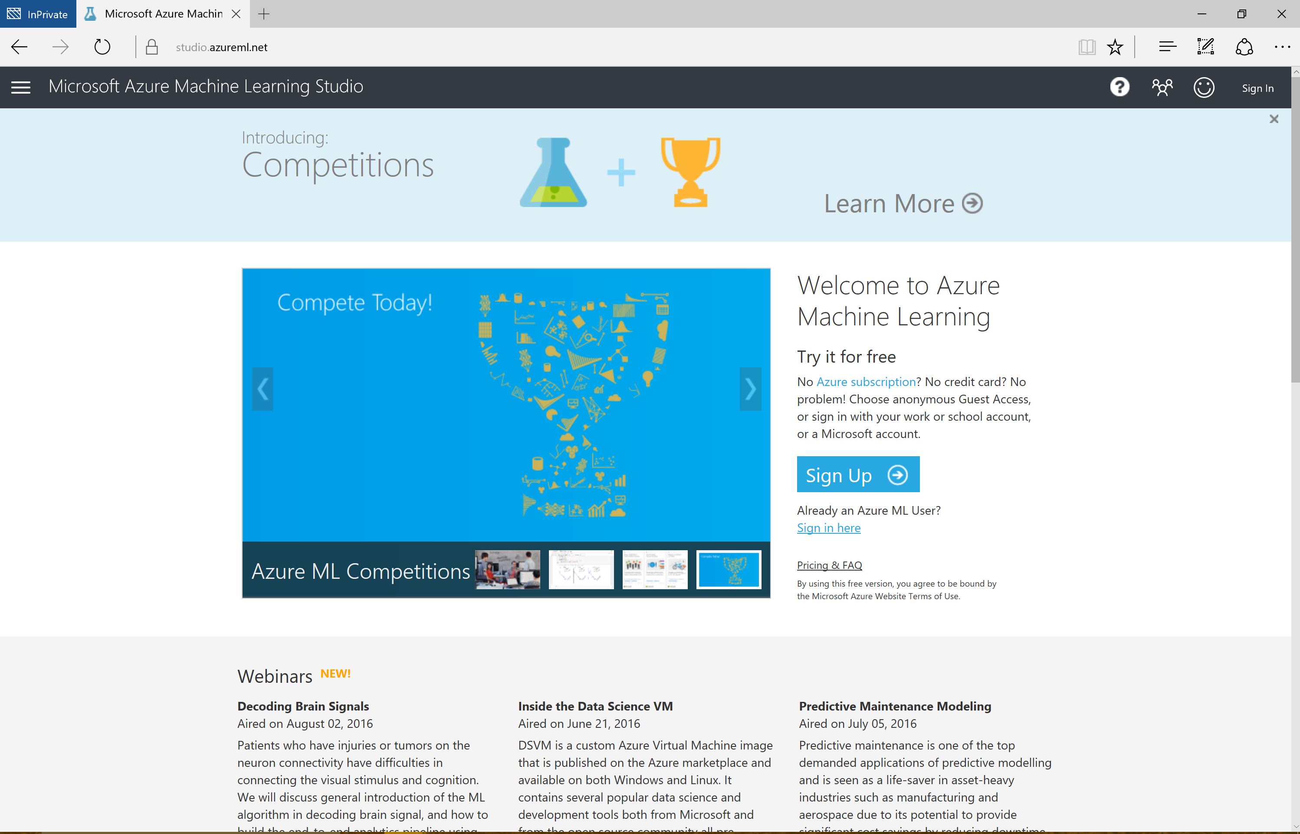

Slide 16
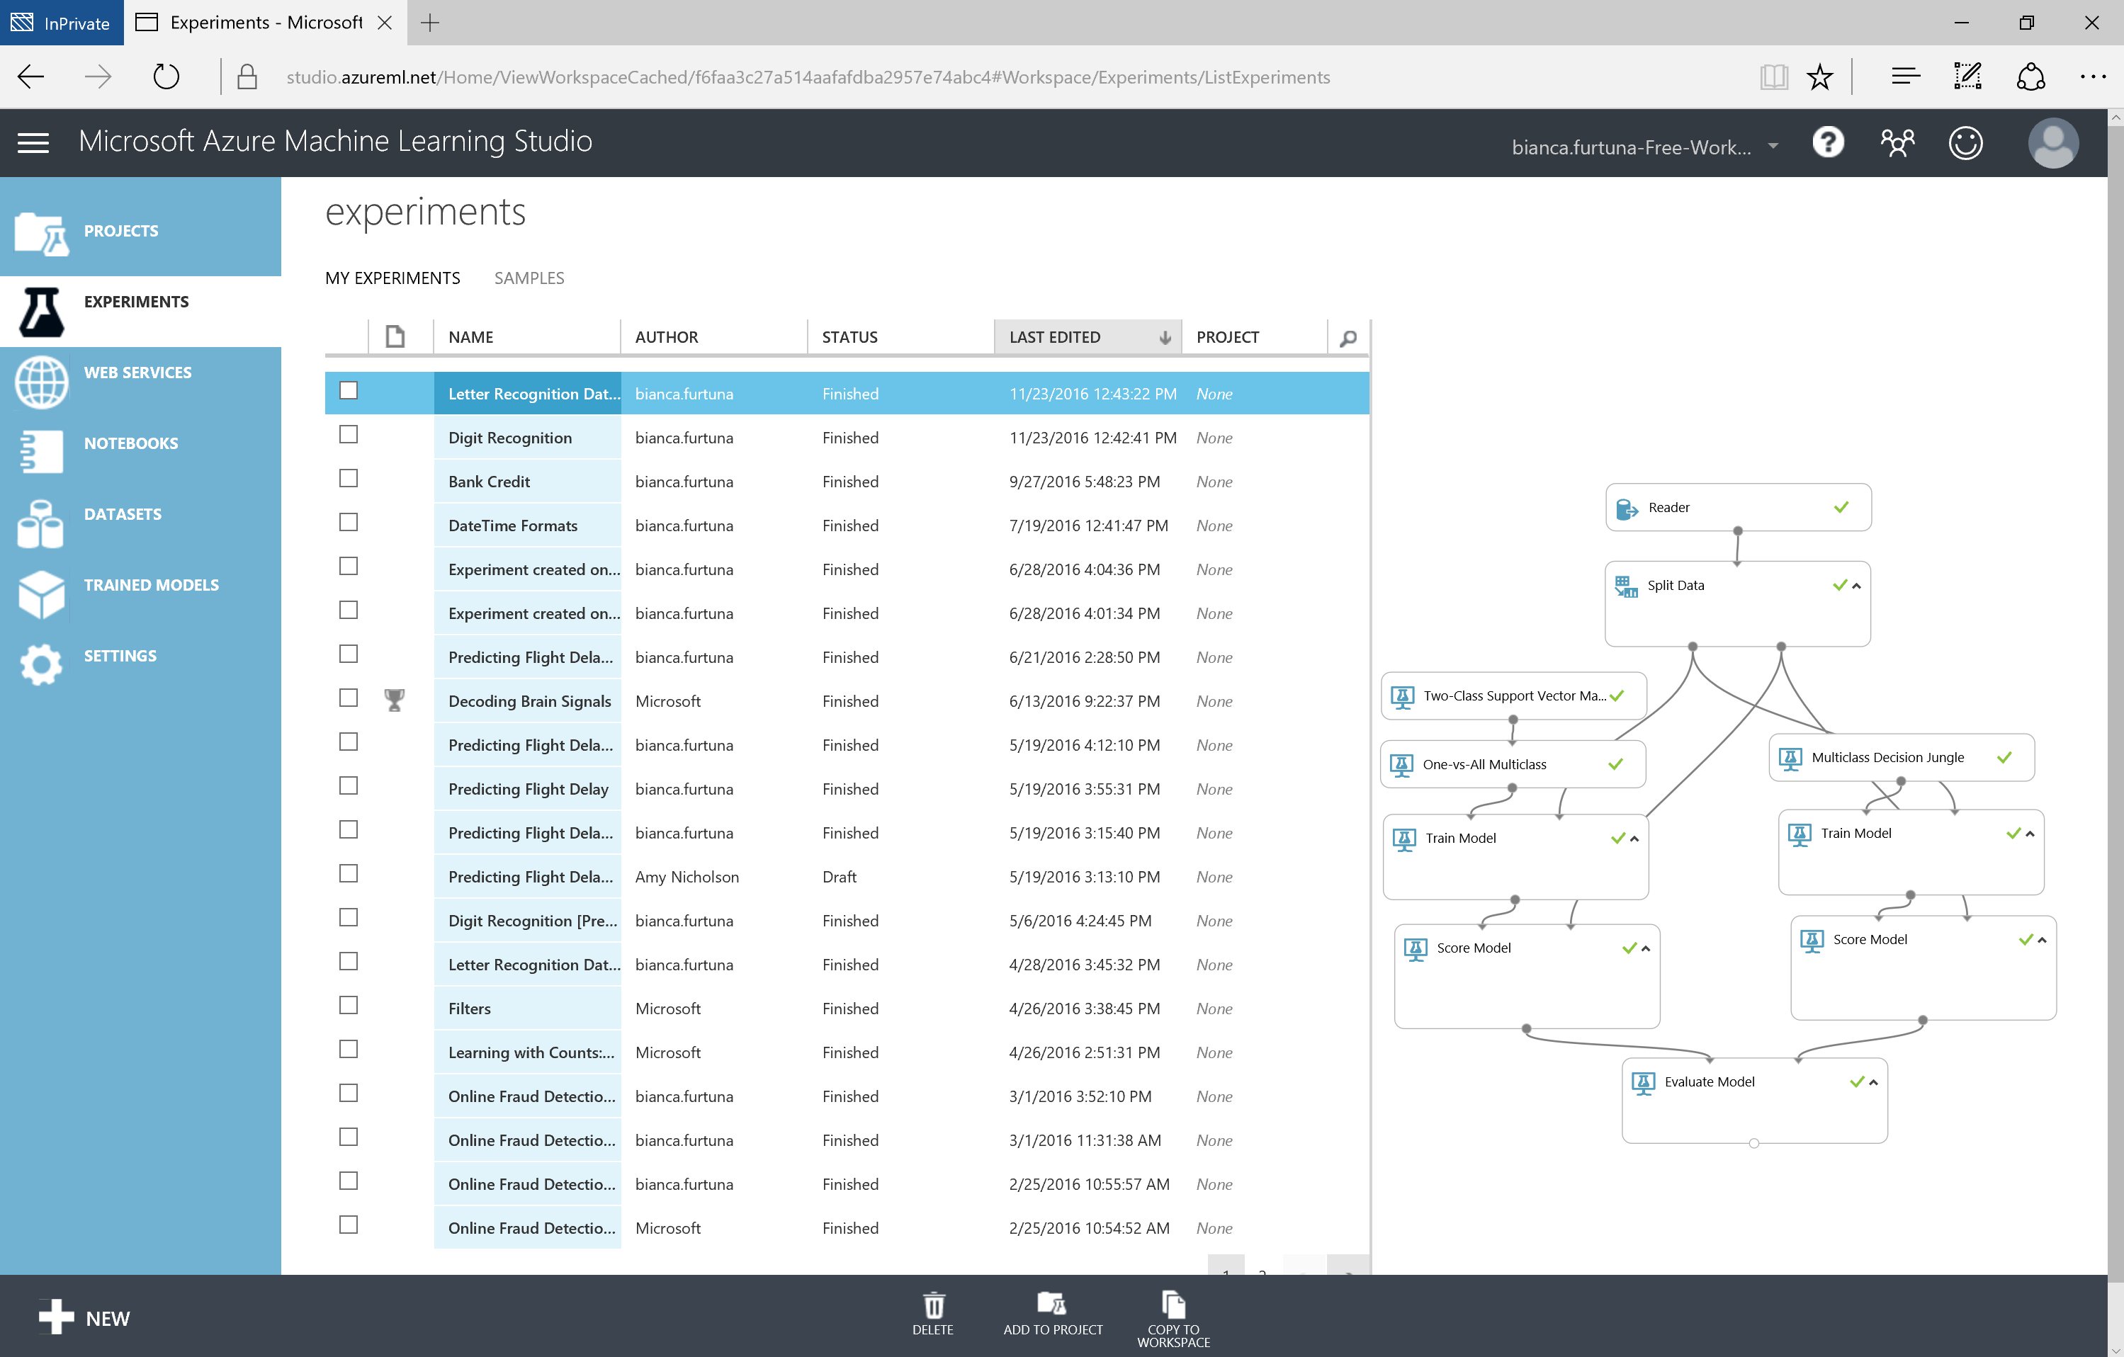

Slide 17
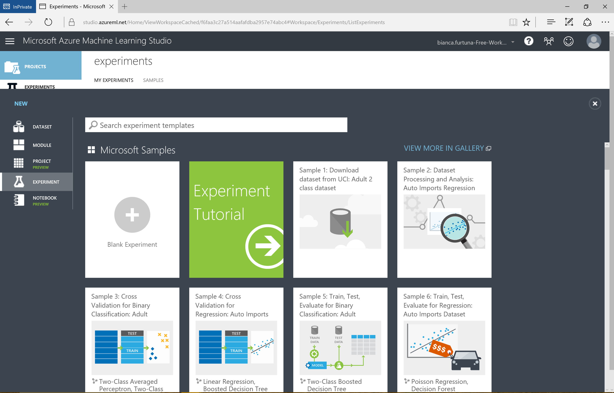

Slide 18
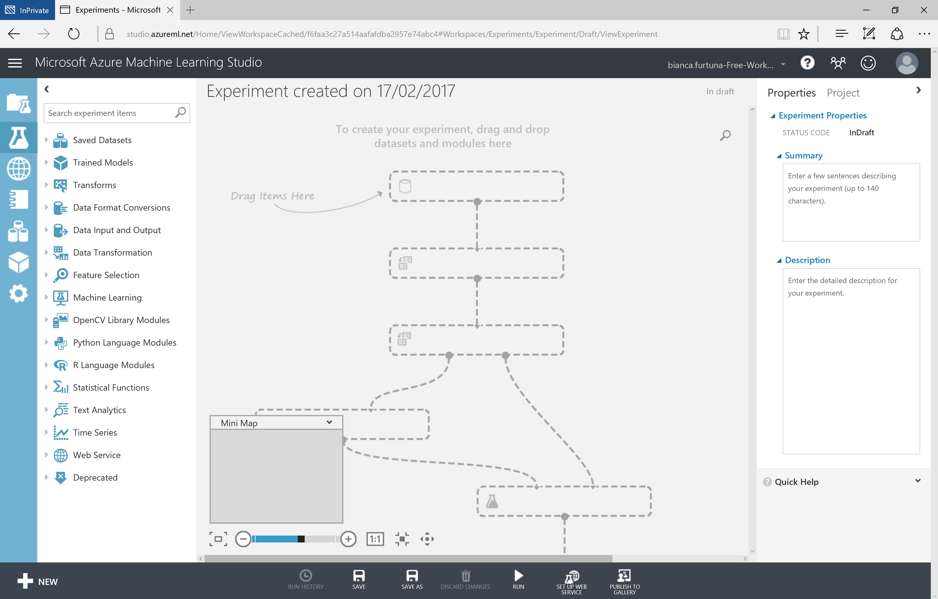

Slide 19
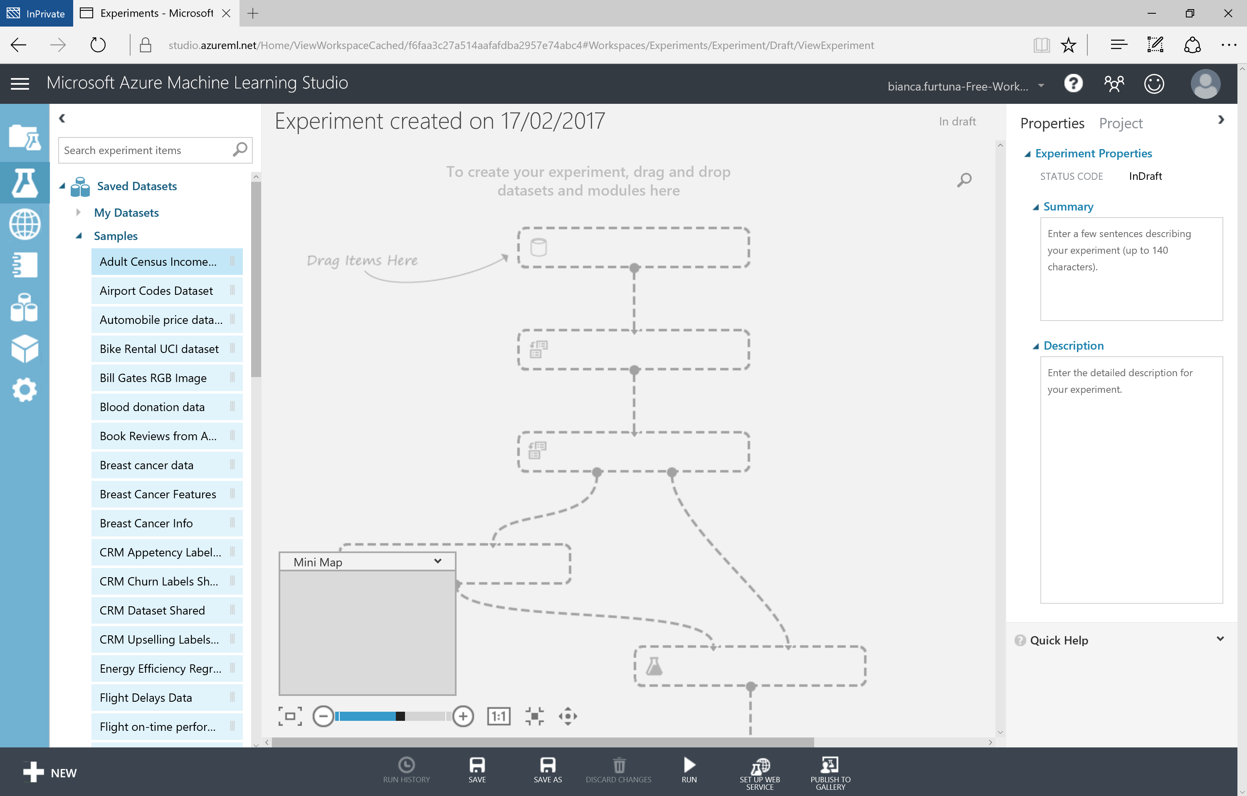

Slide 20
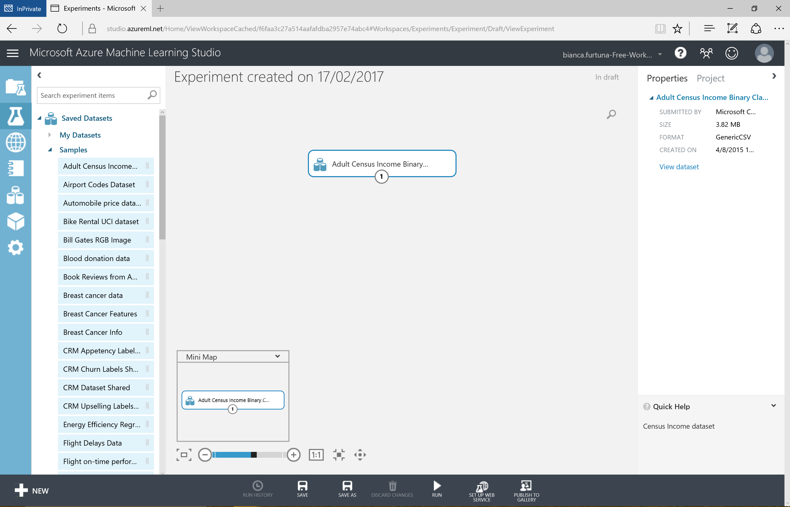

Slide 21
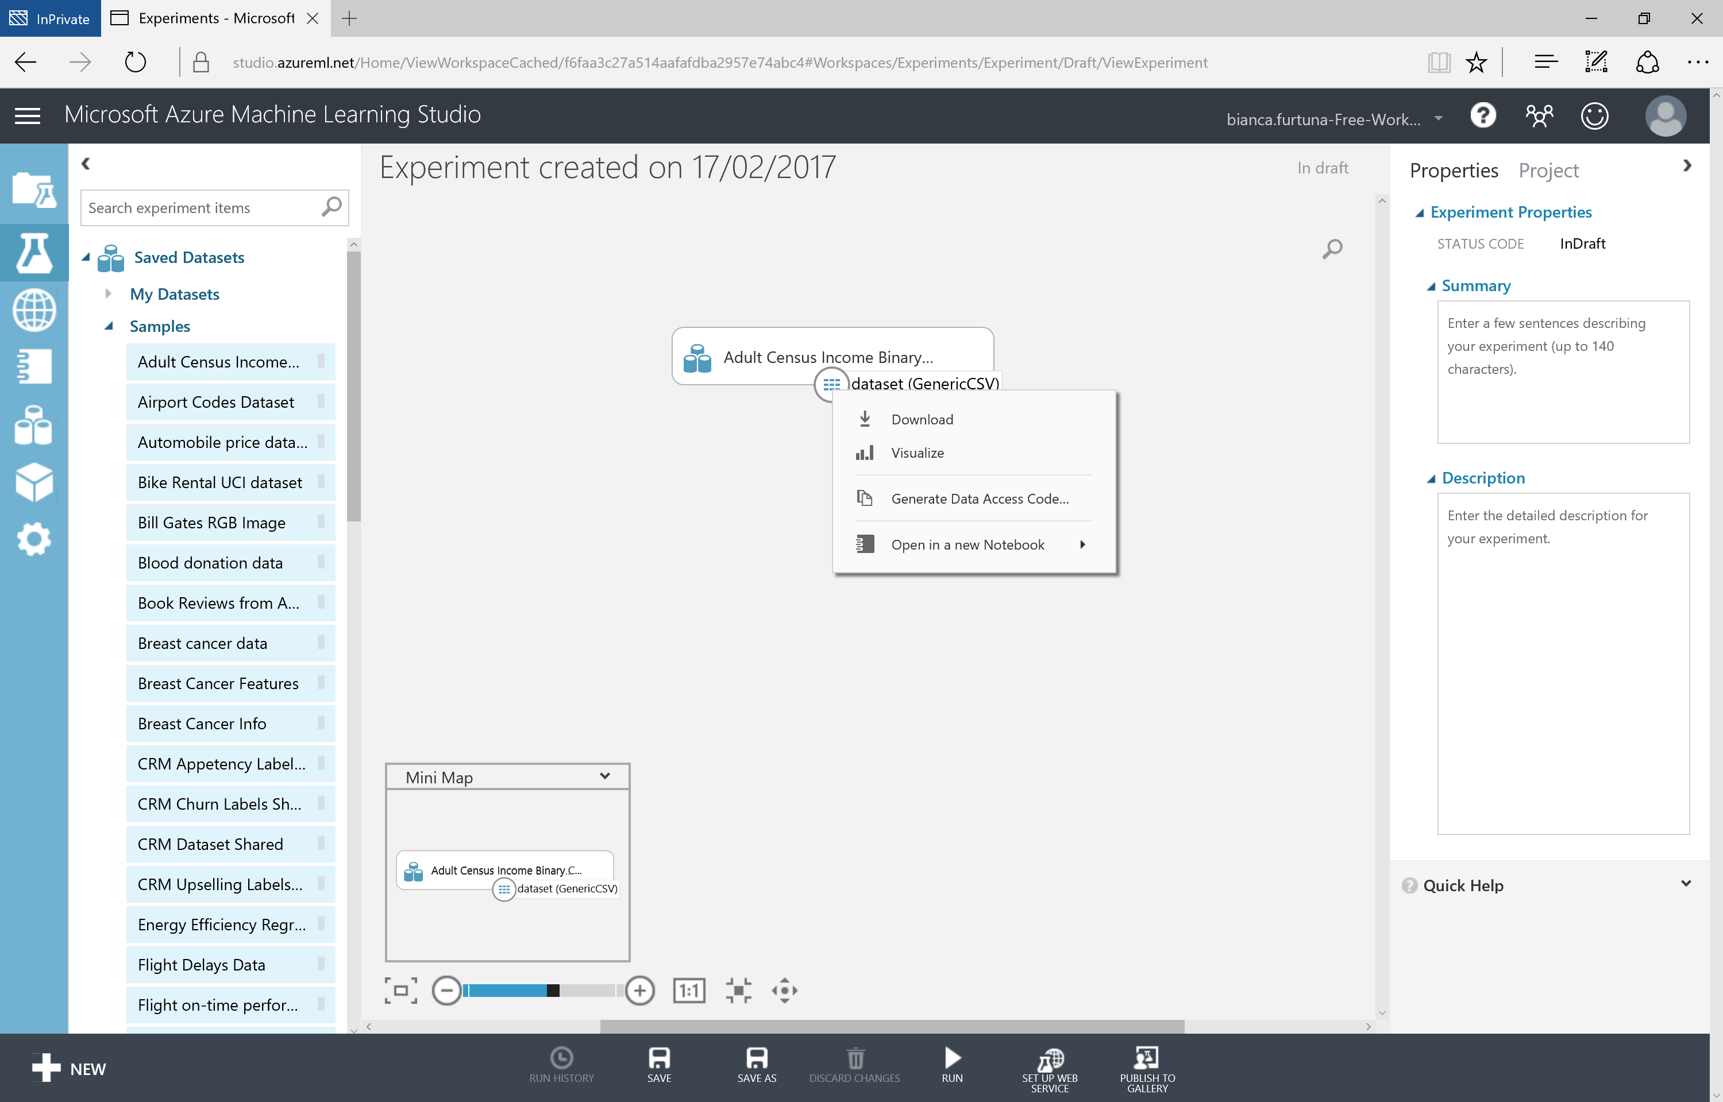

Slide 22
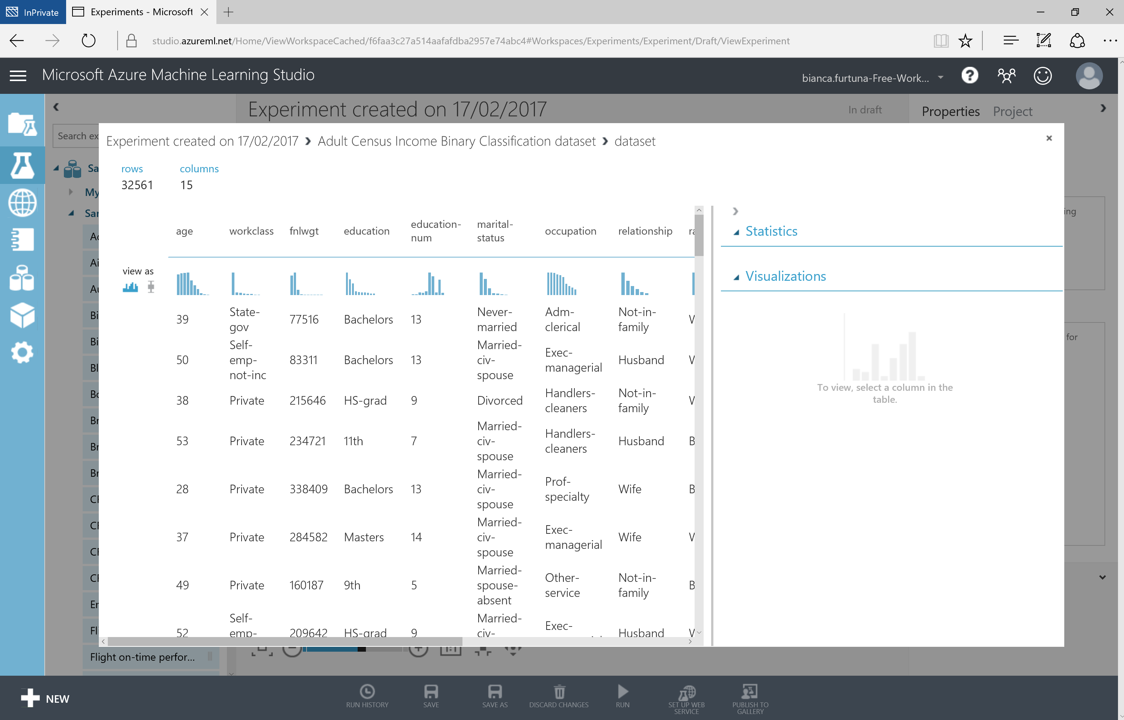

Slide 23
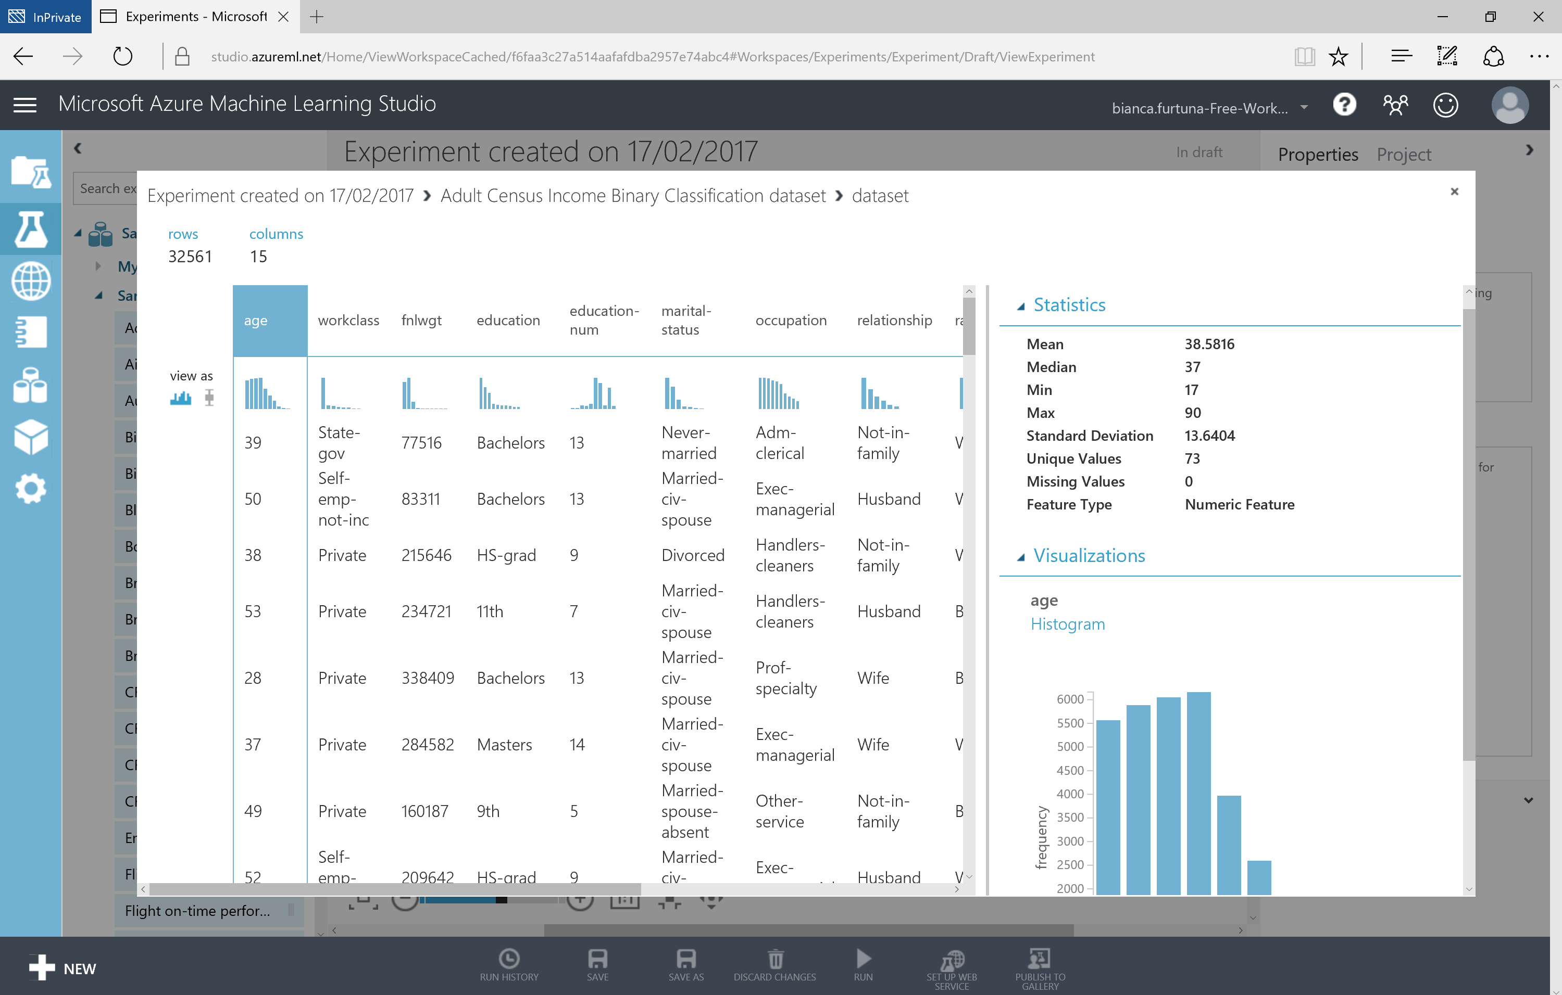

Slide 24
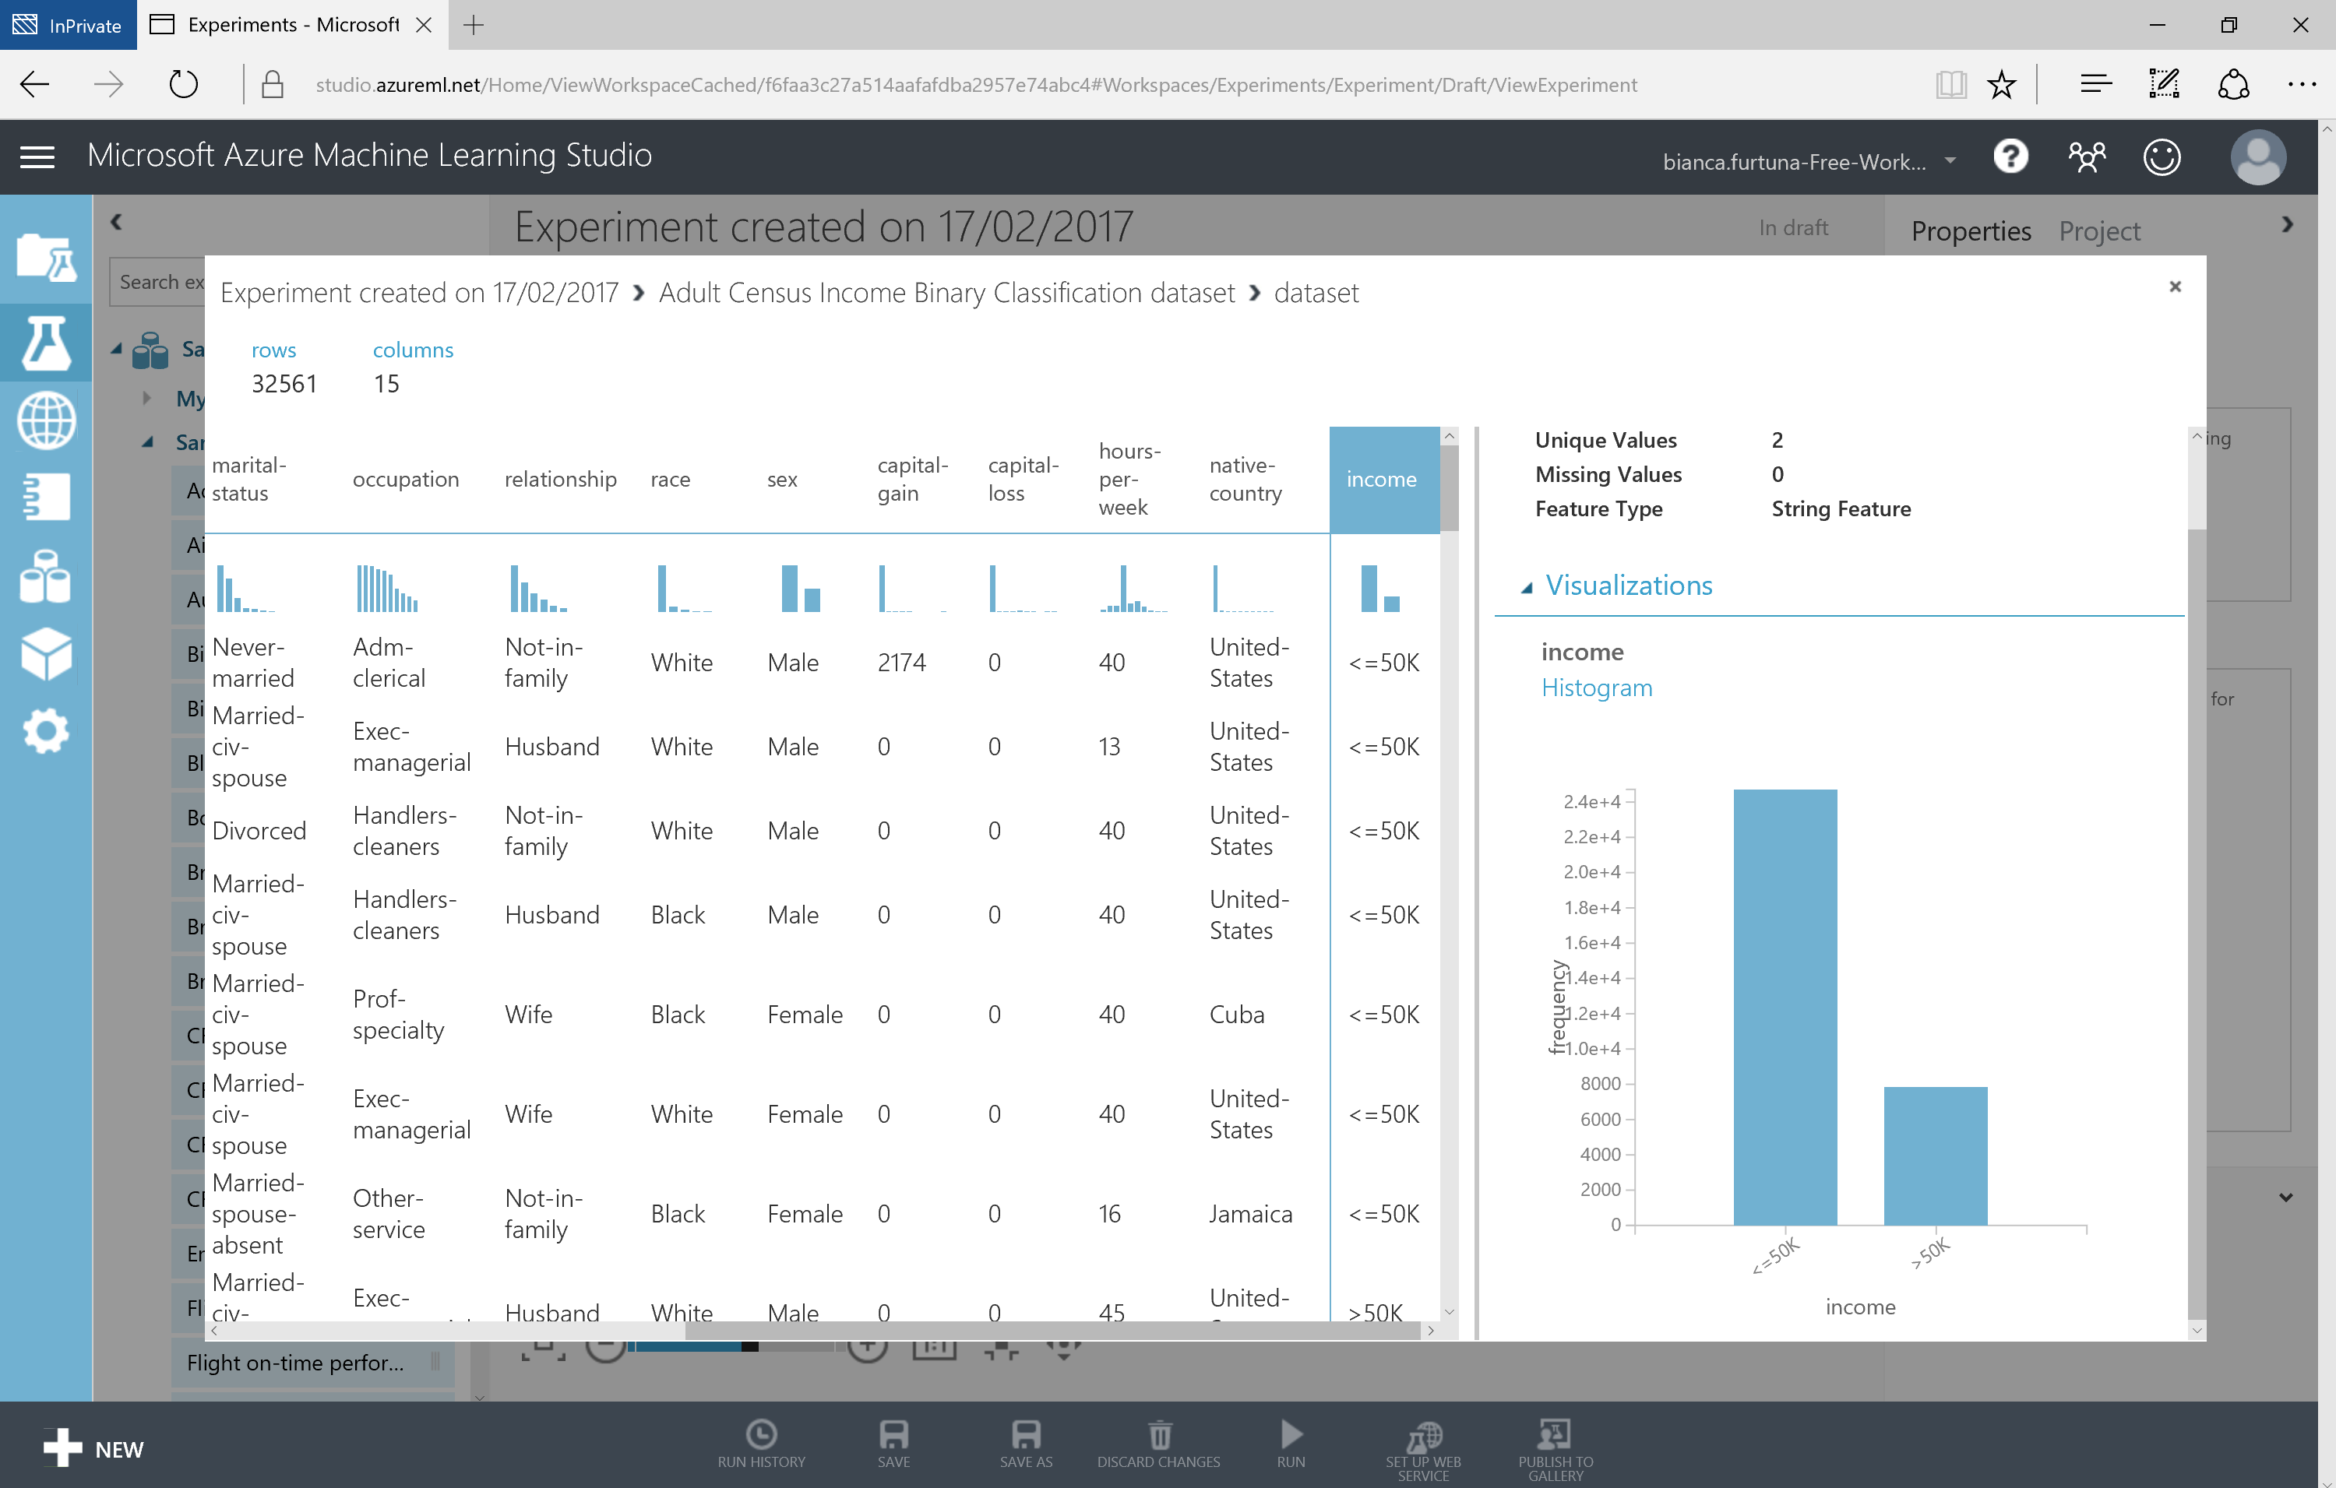

Slide 25
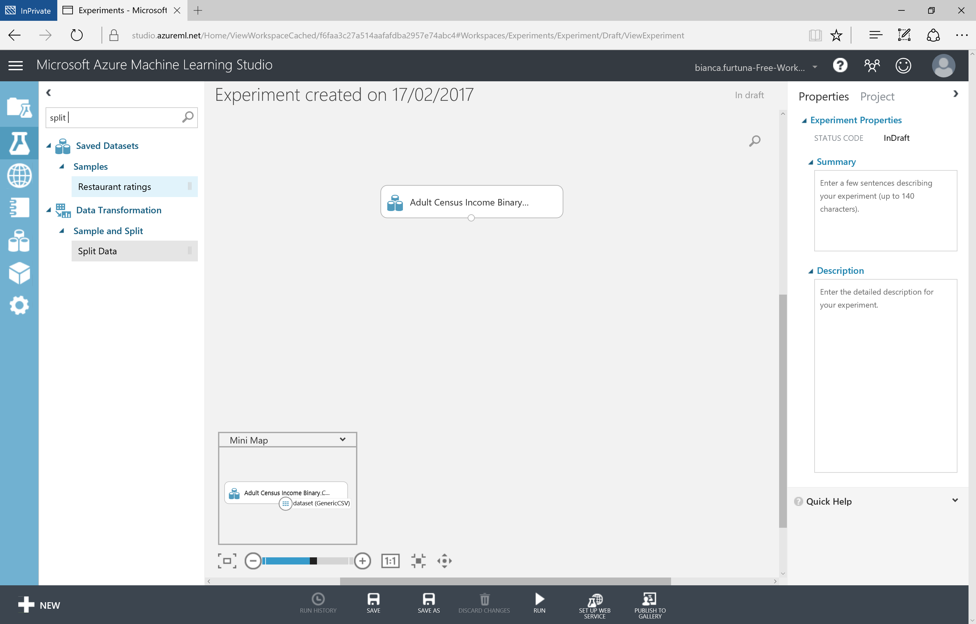

Slide 26
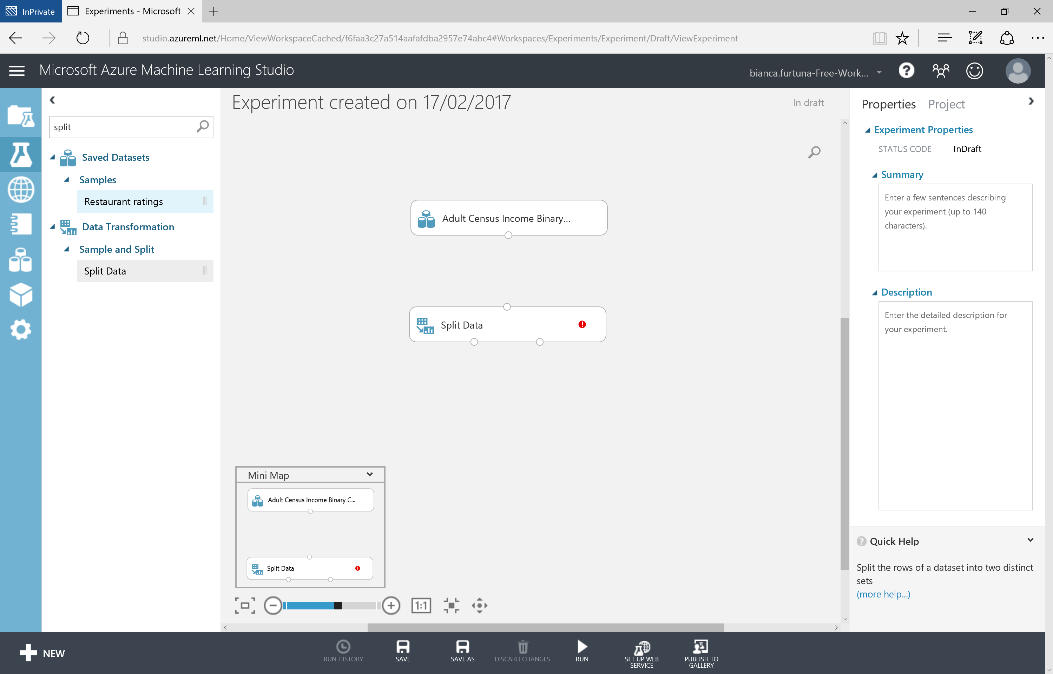

Slide 27
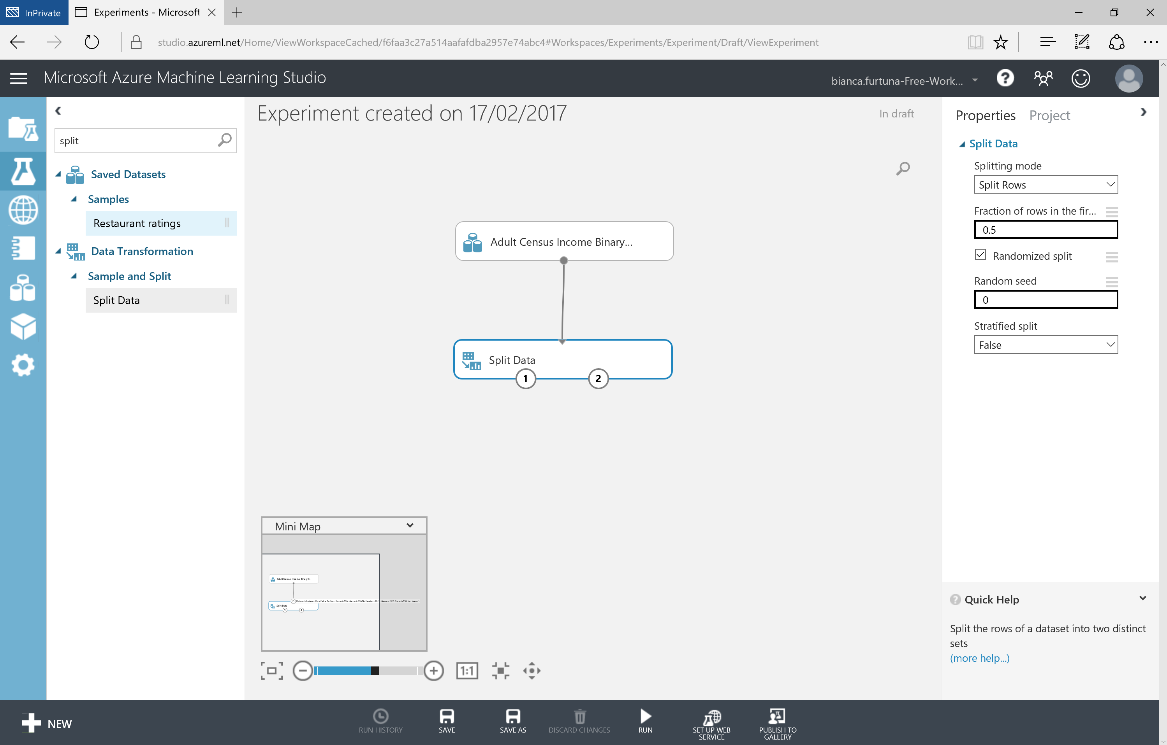

Slide 28
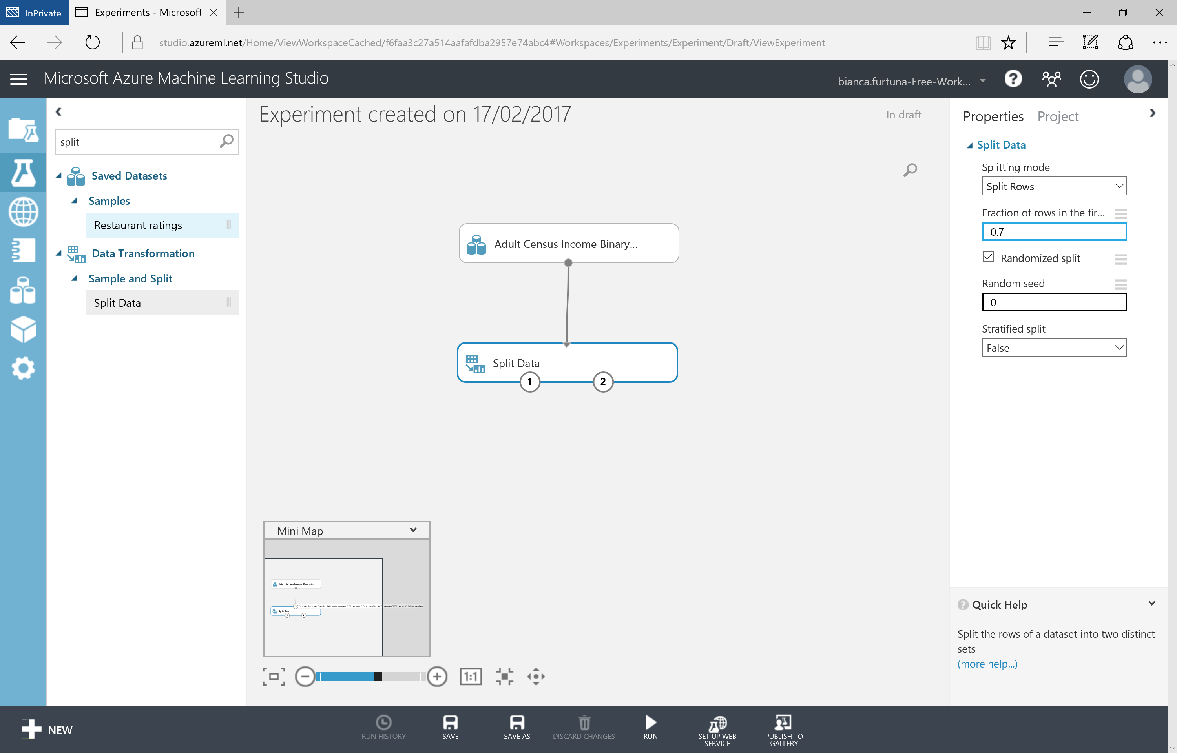

Slide 29
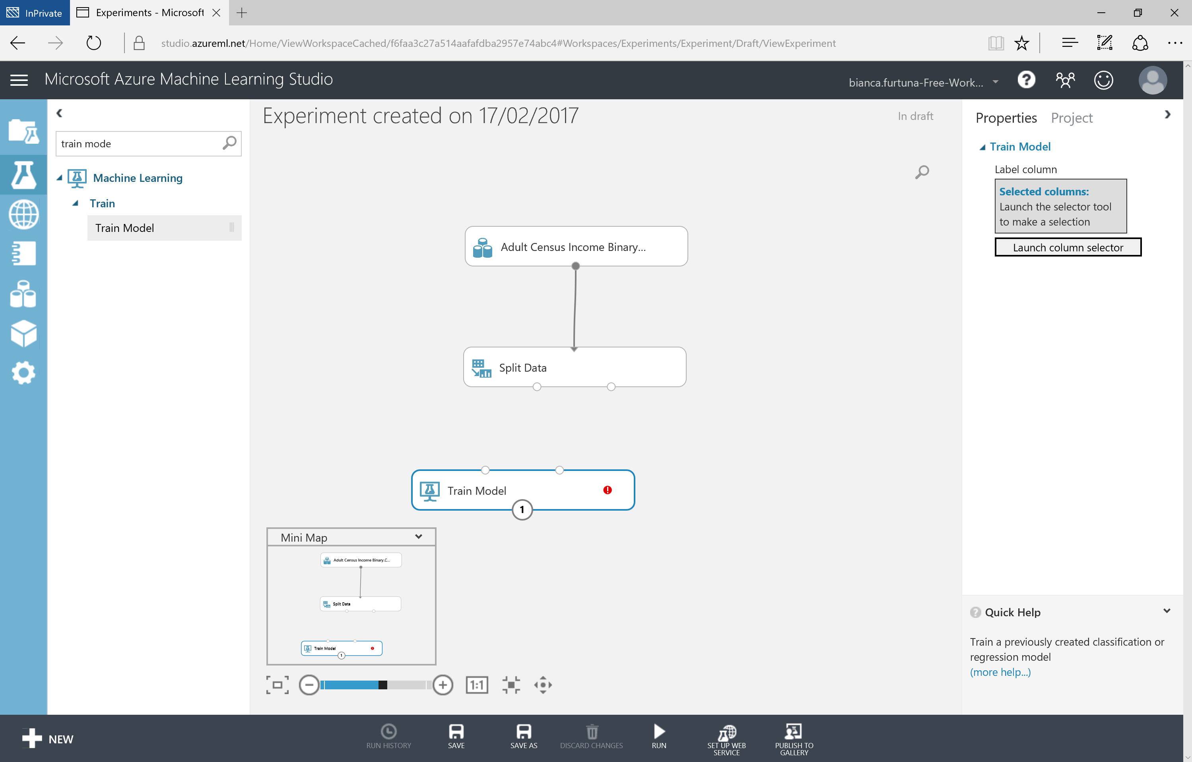

Slide 30
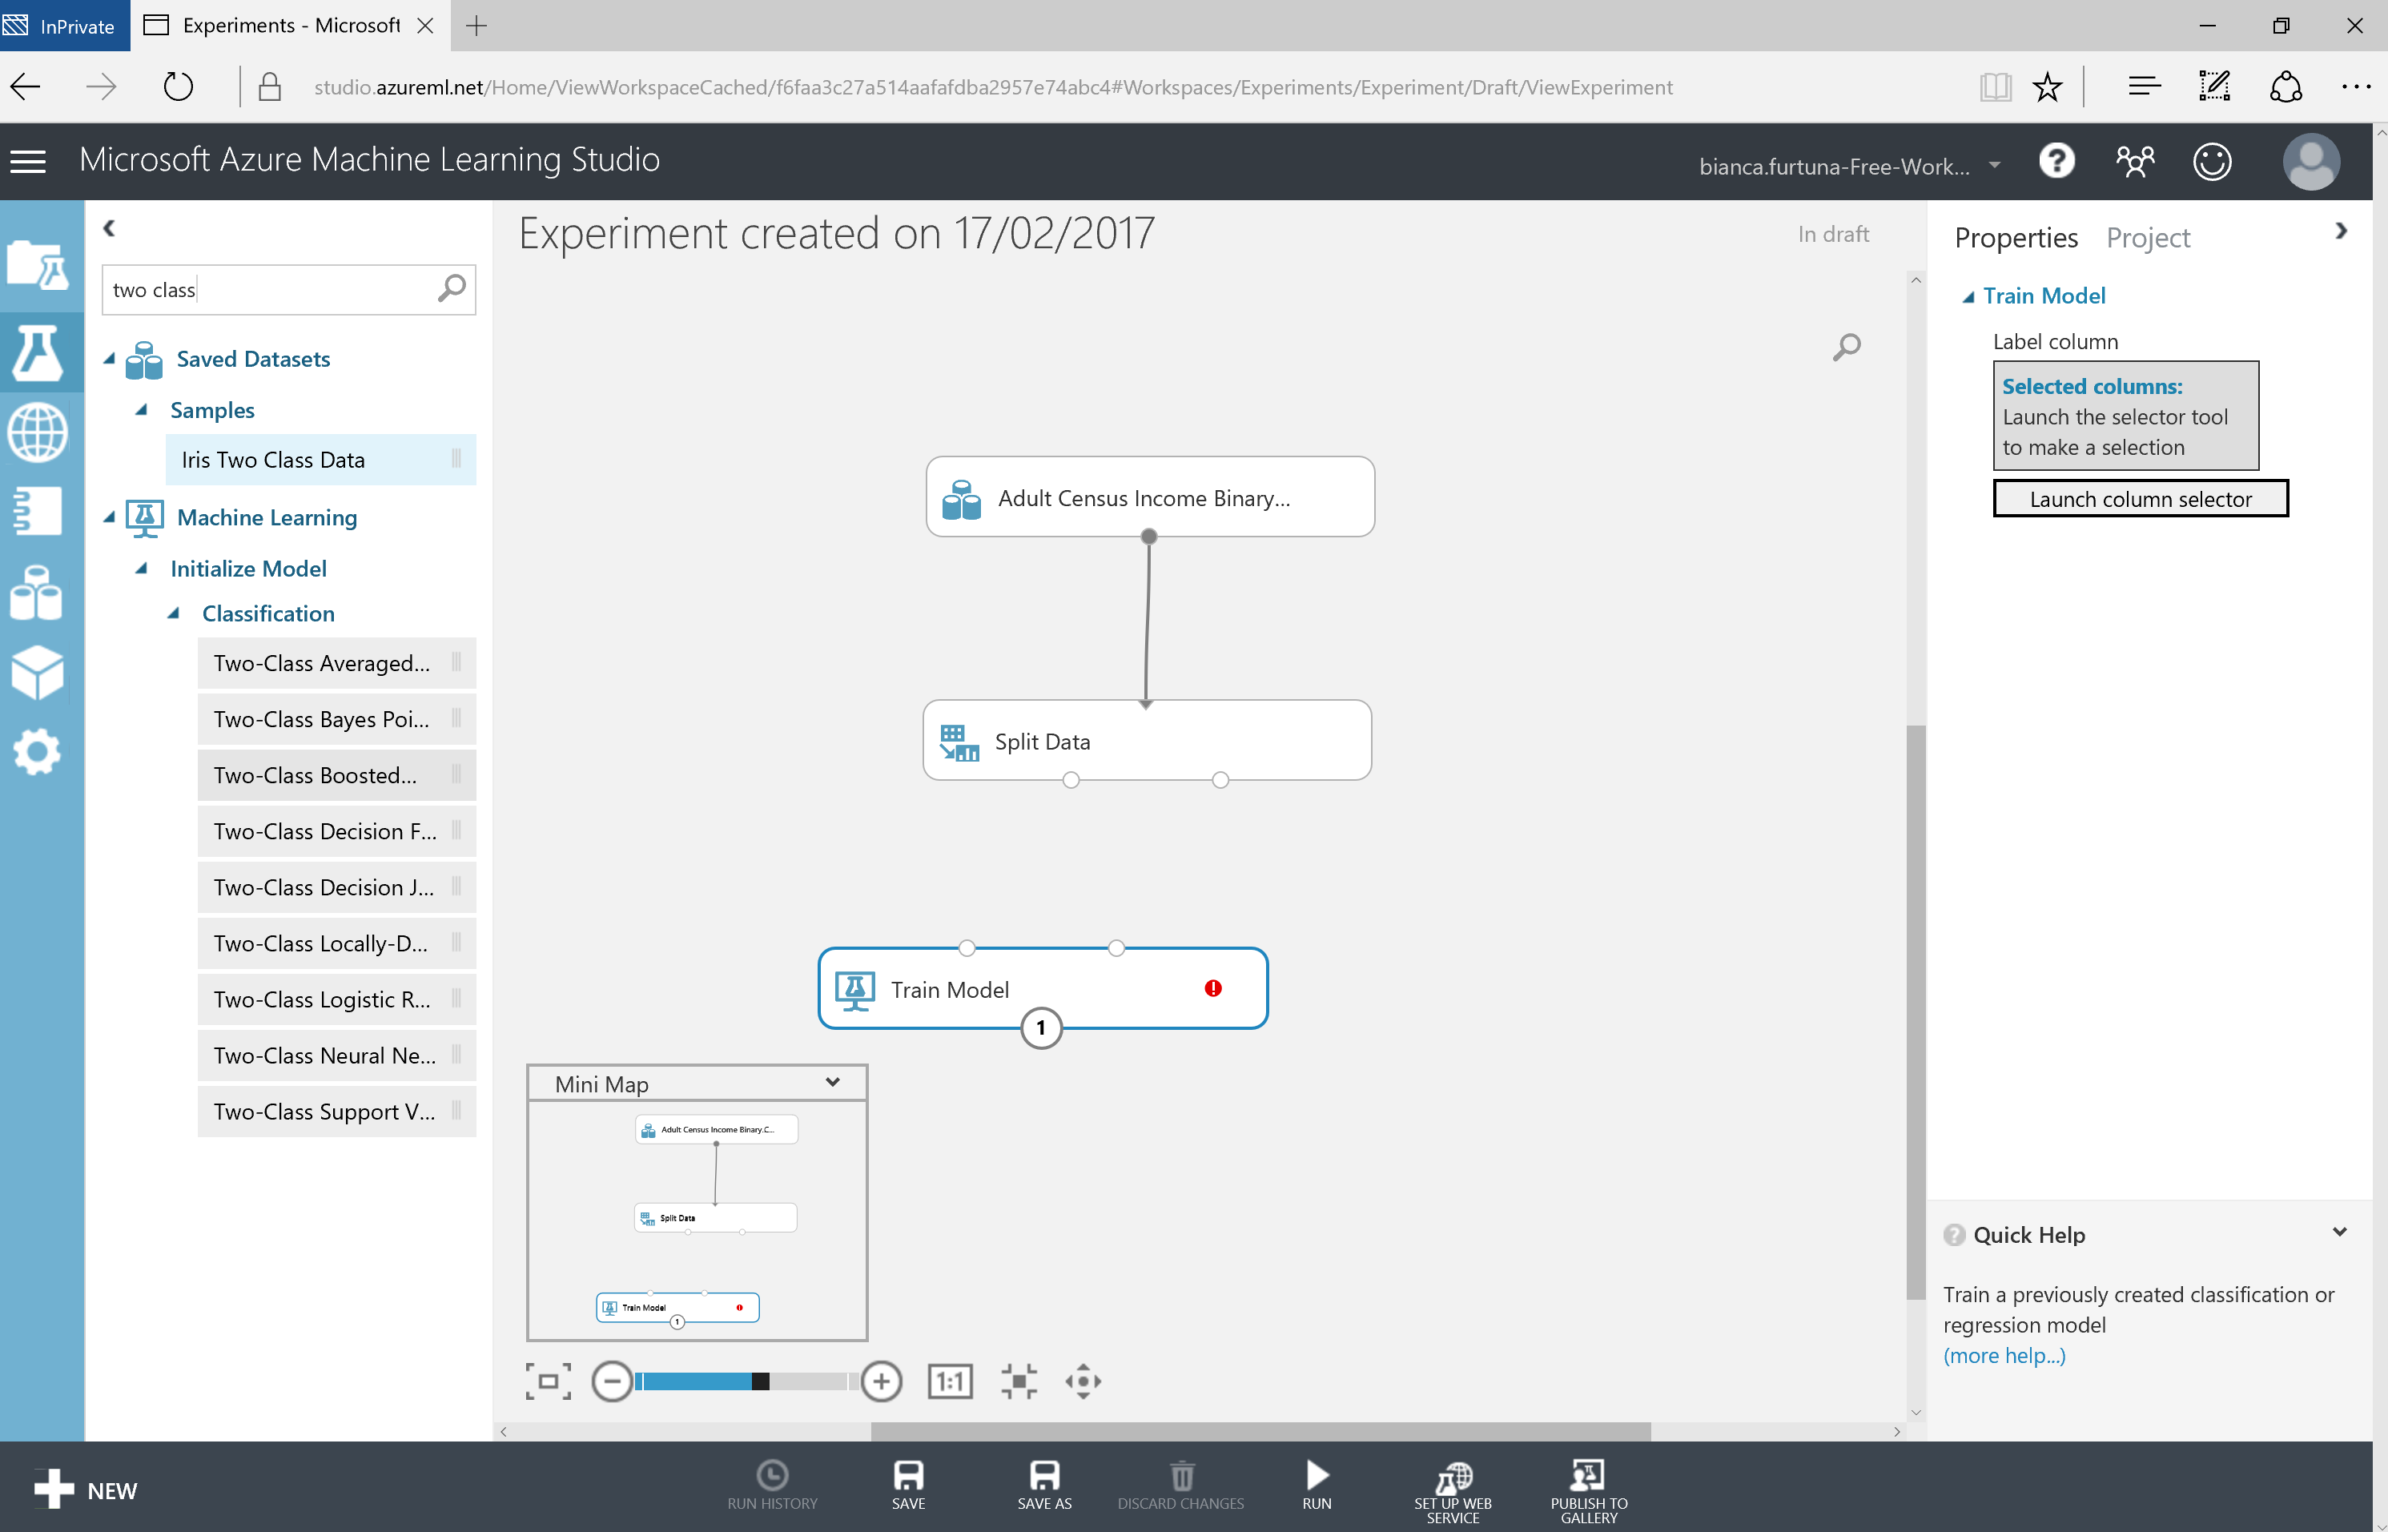

Slide 31
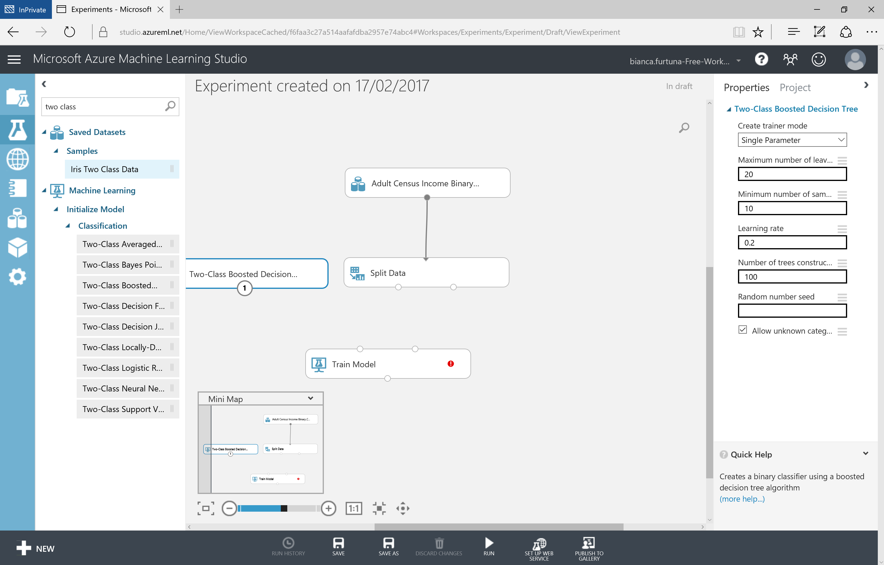

Slide 32
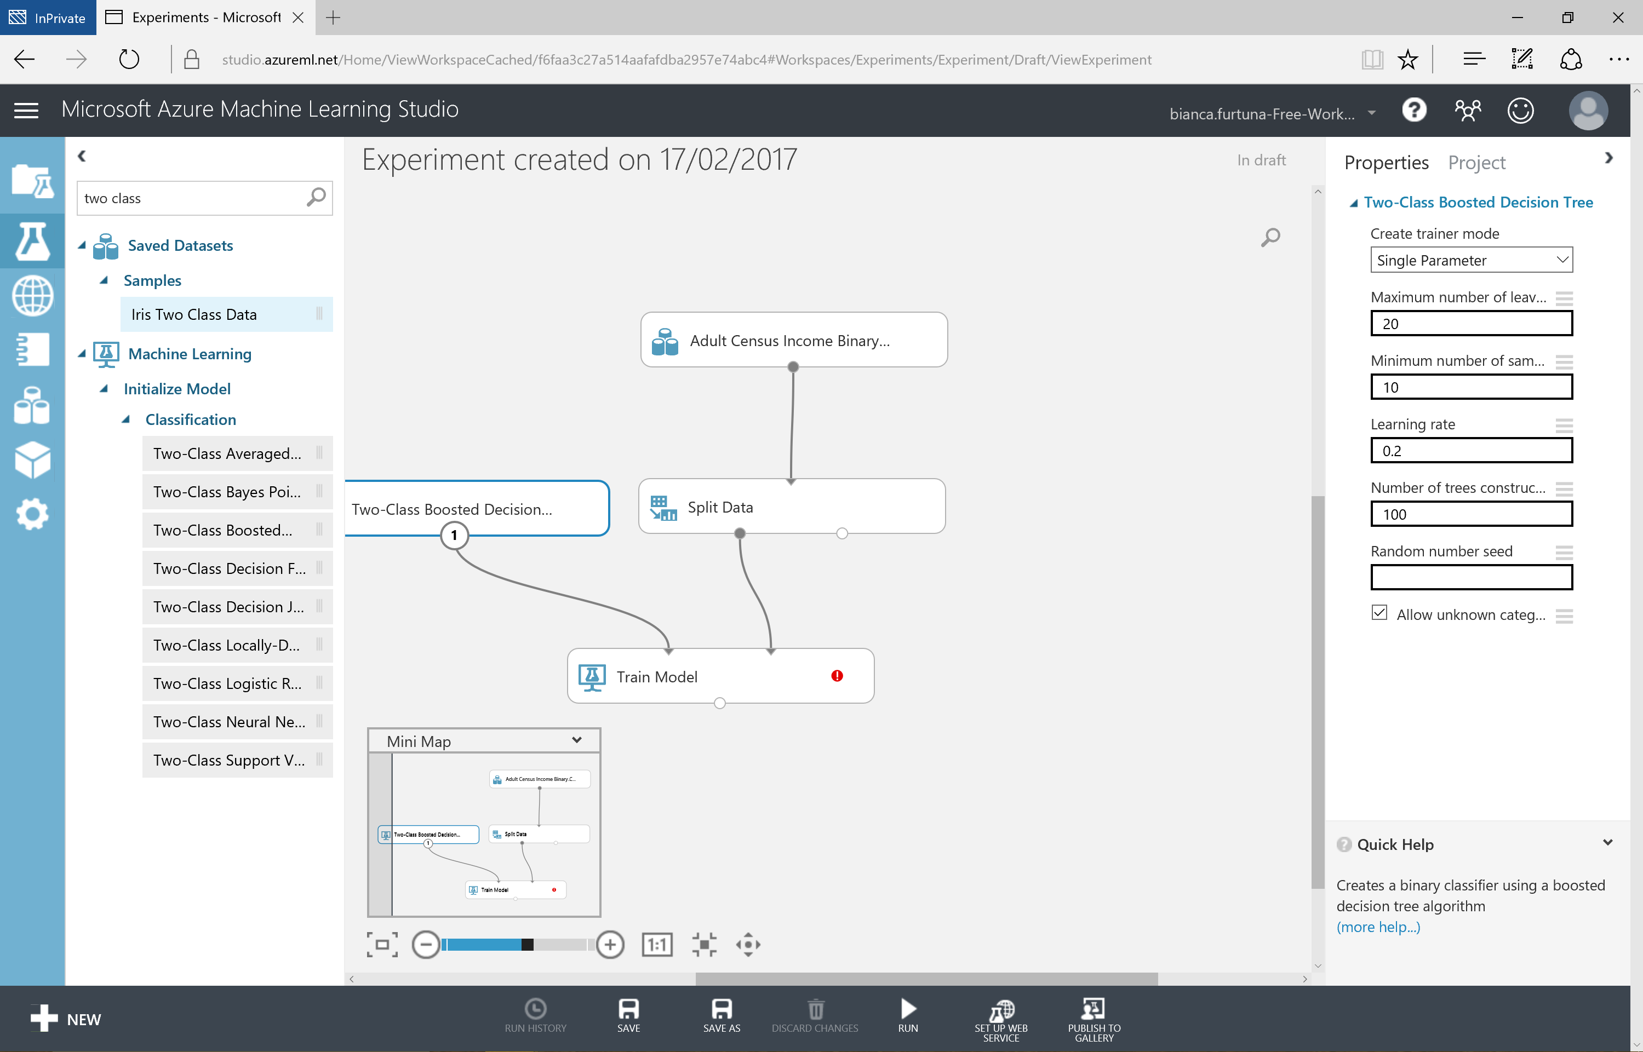

Slide 33
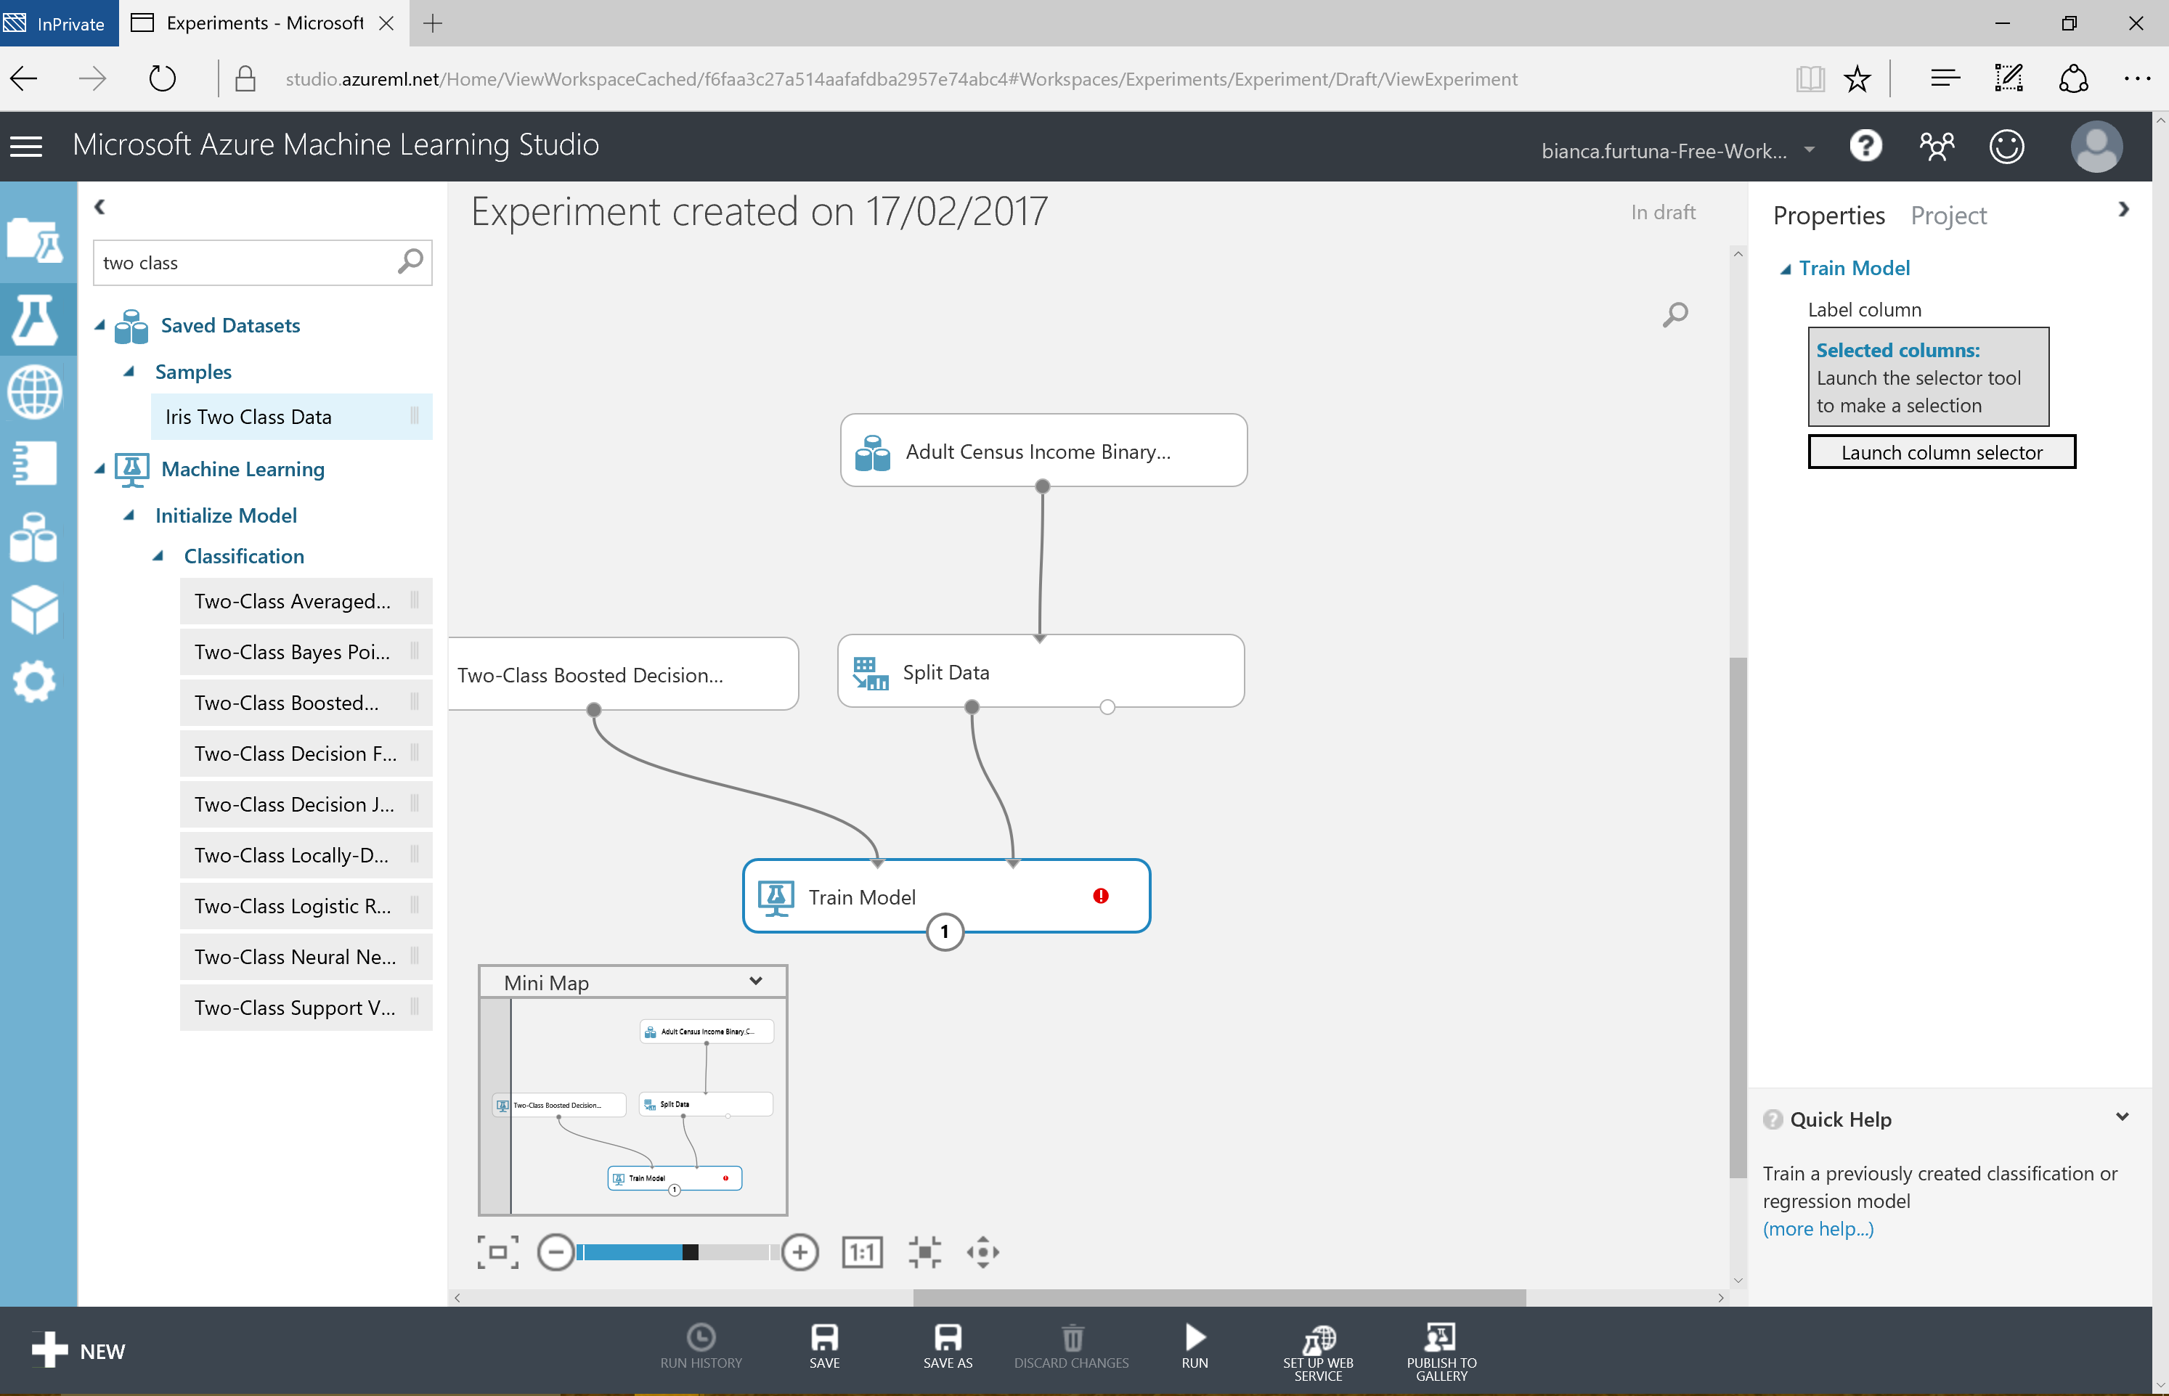

Slide 34
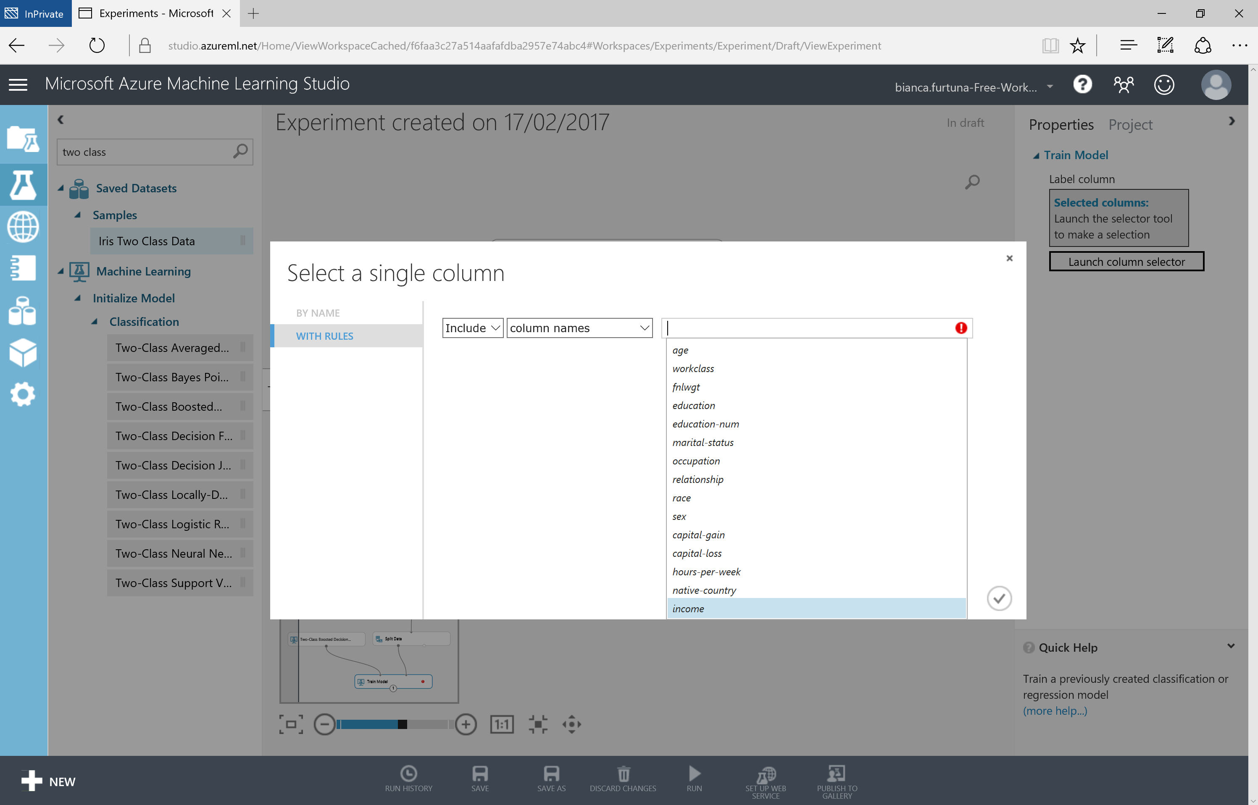

Slide 35
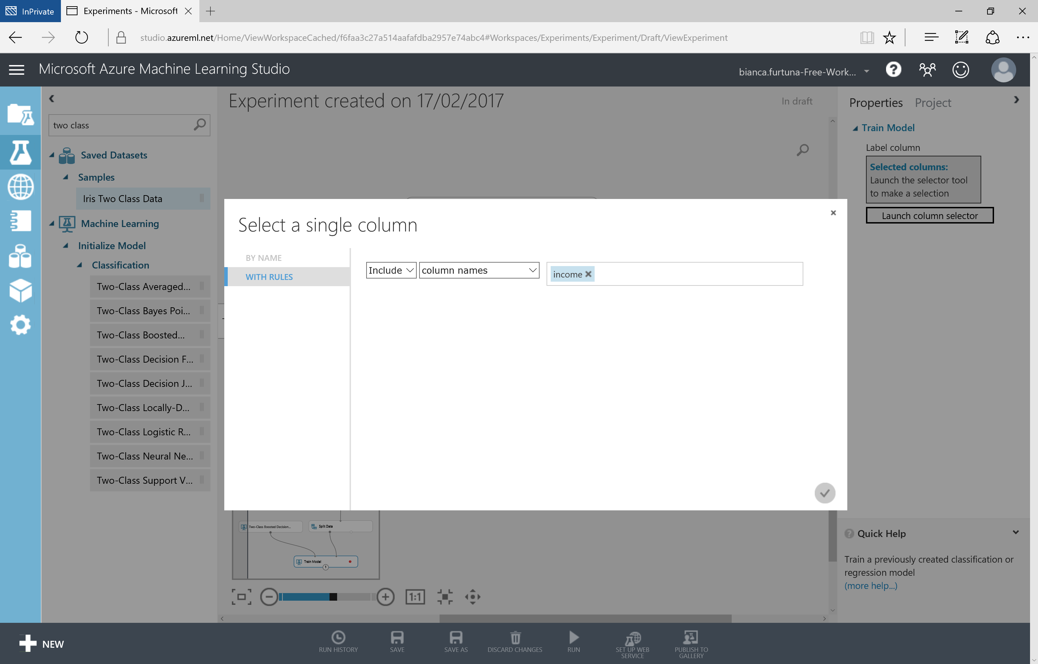

Slide 36
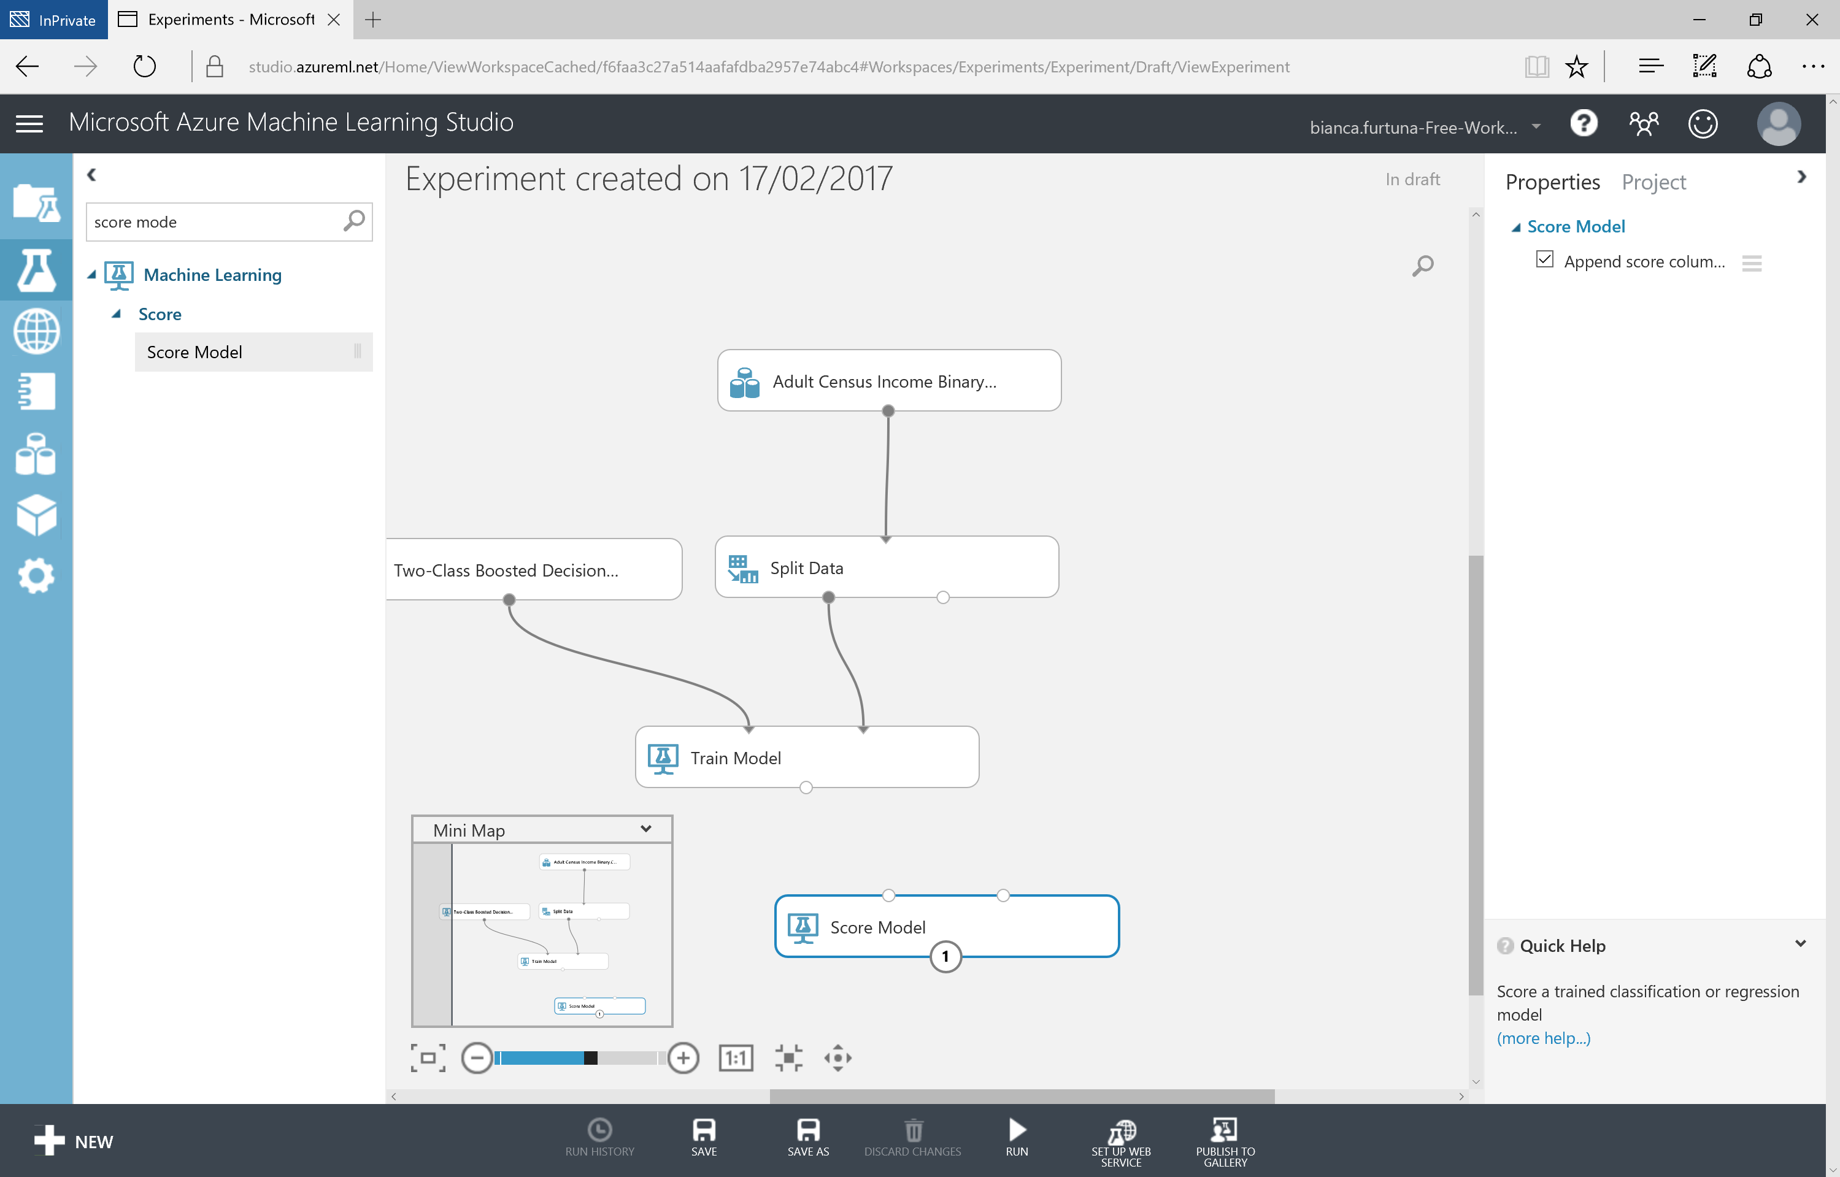

Slide 37


Slide 38
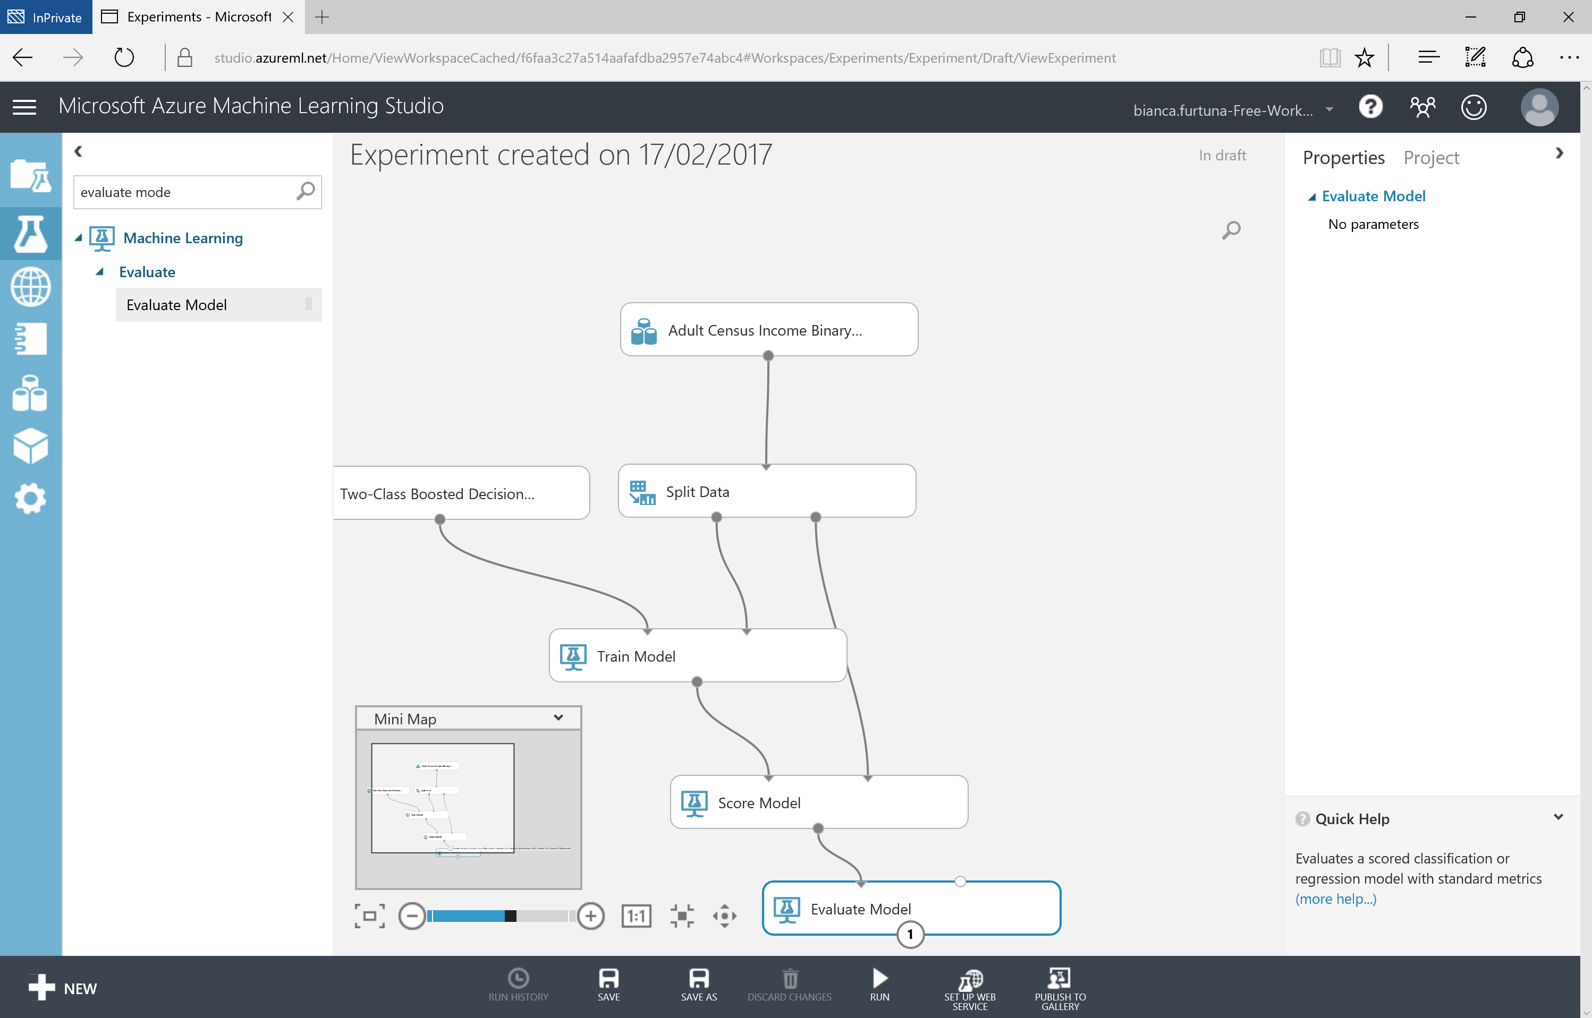

Slide 39
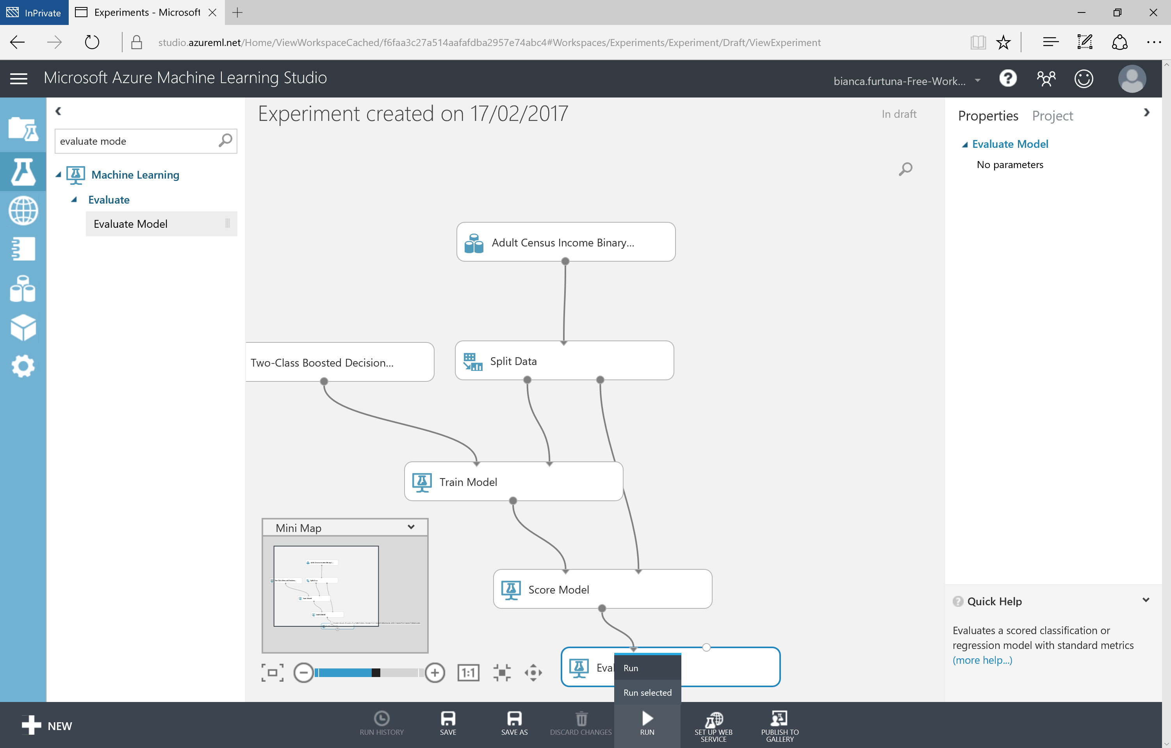

Slide 40
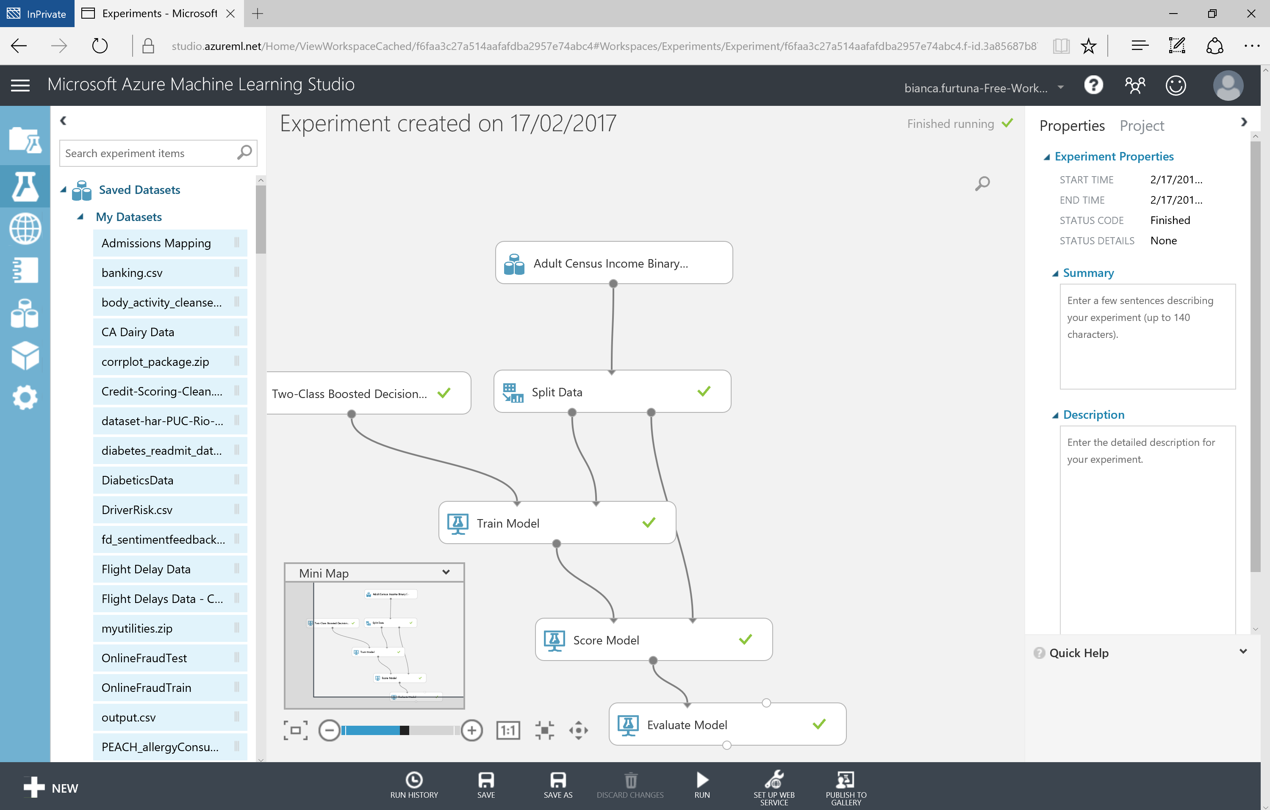

Slide 41
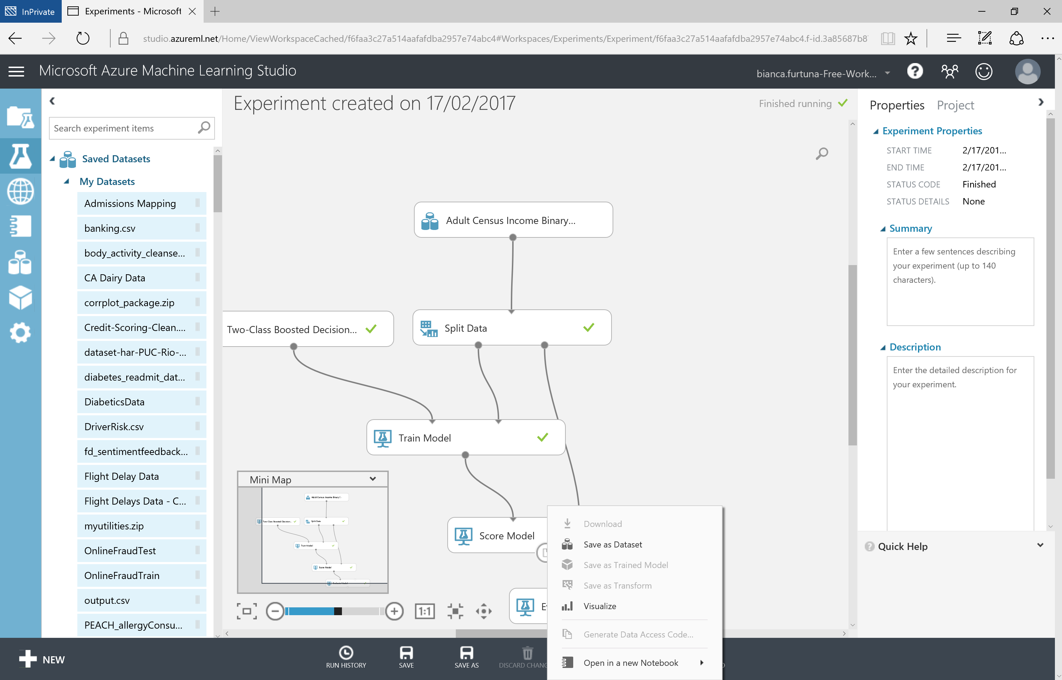

Slide 42
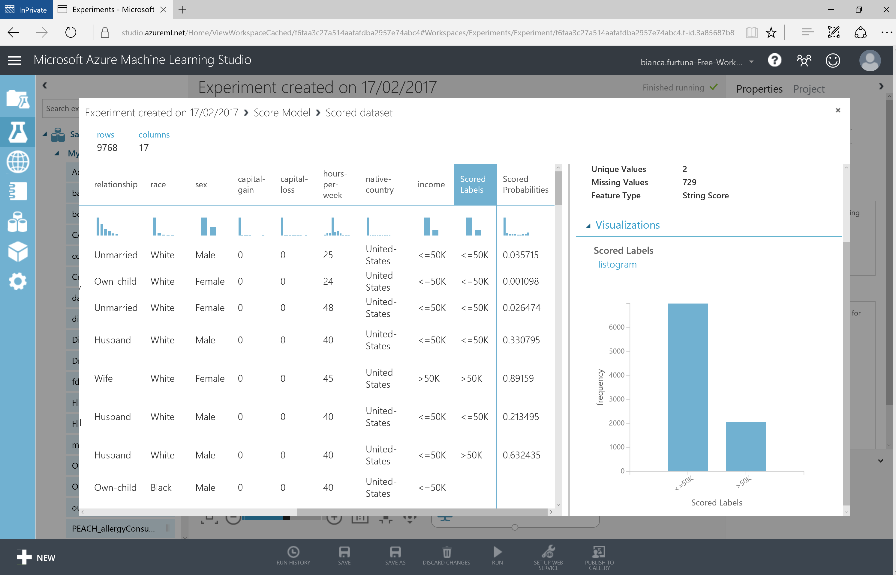

Slide 43
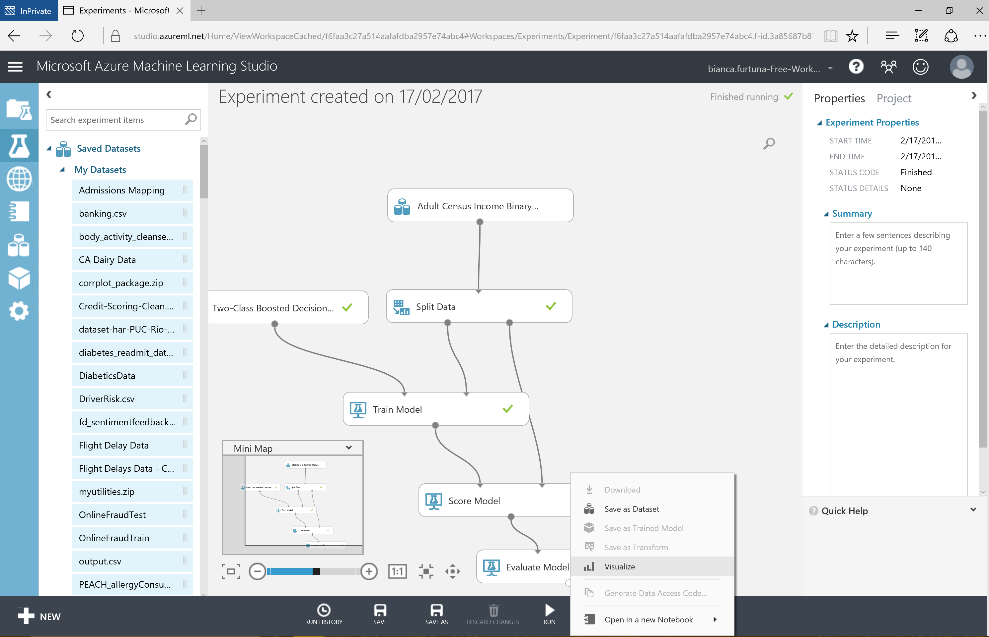

Slide 44
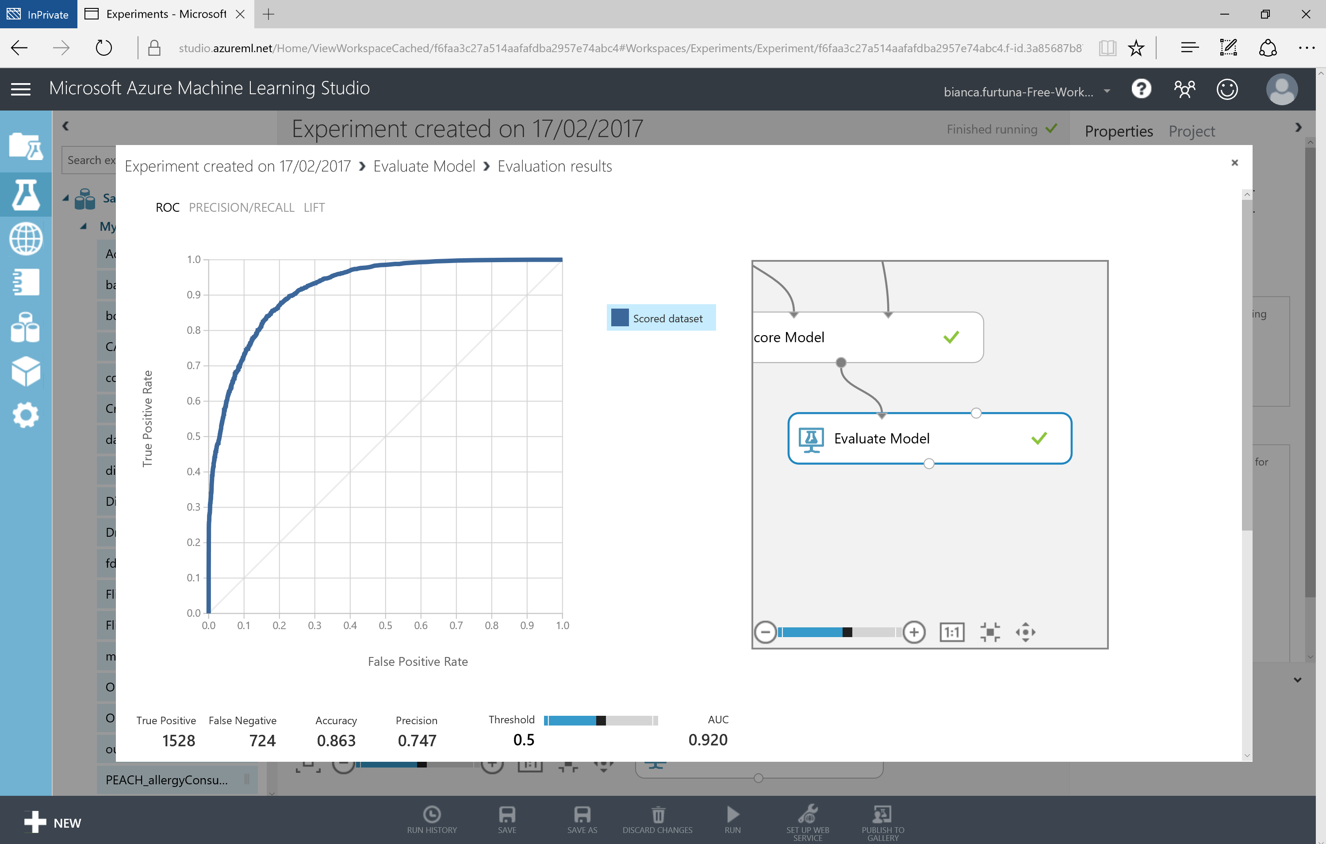

Slide 45
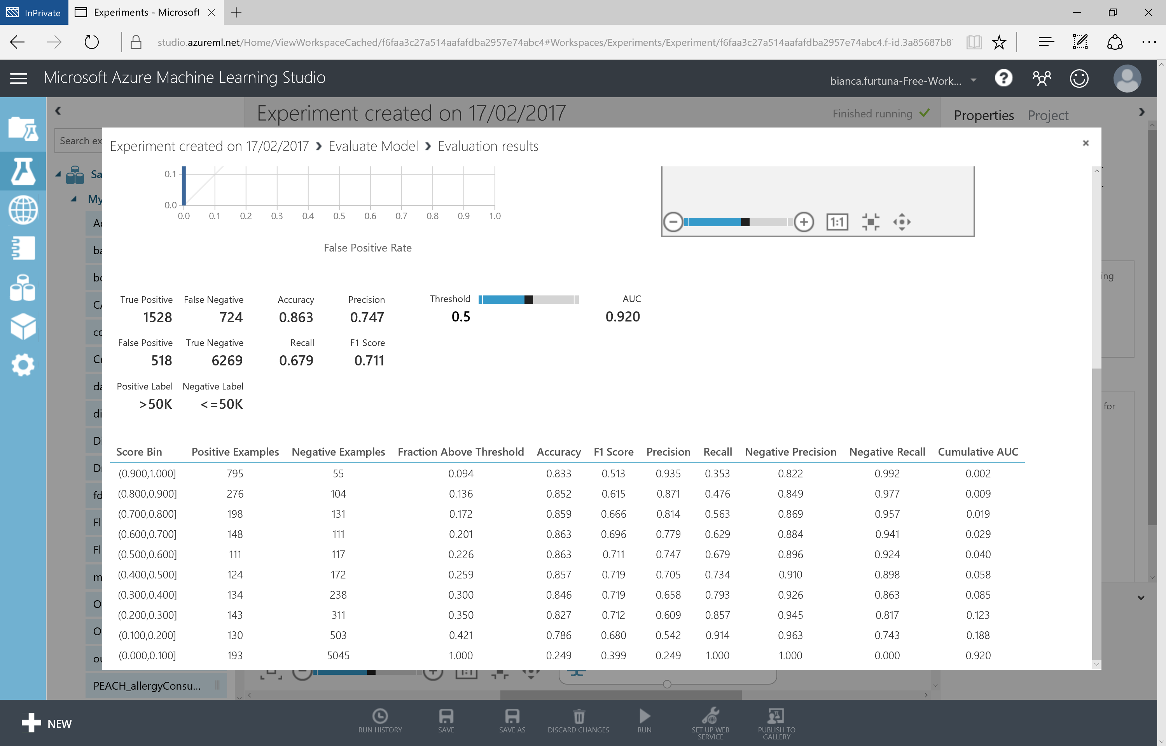

Slide 46
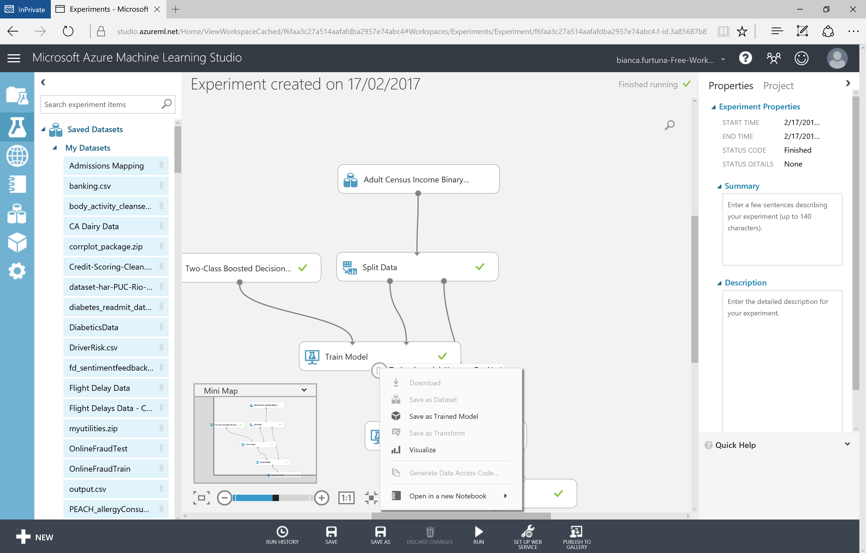

Slide 47
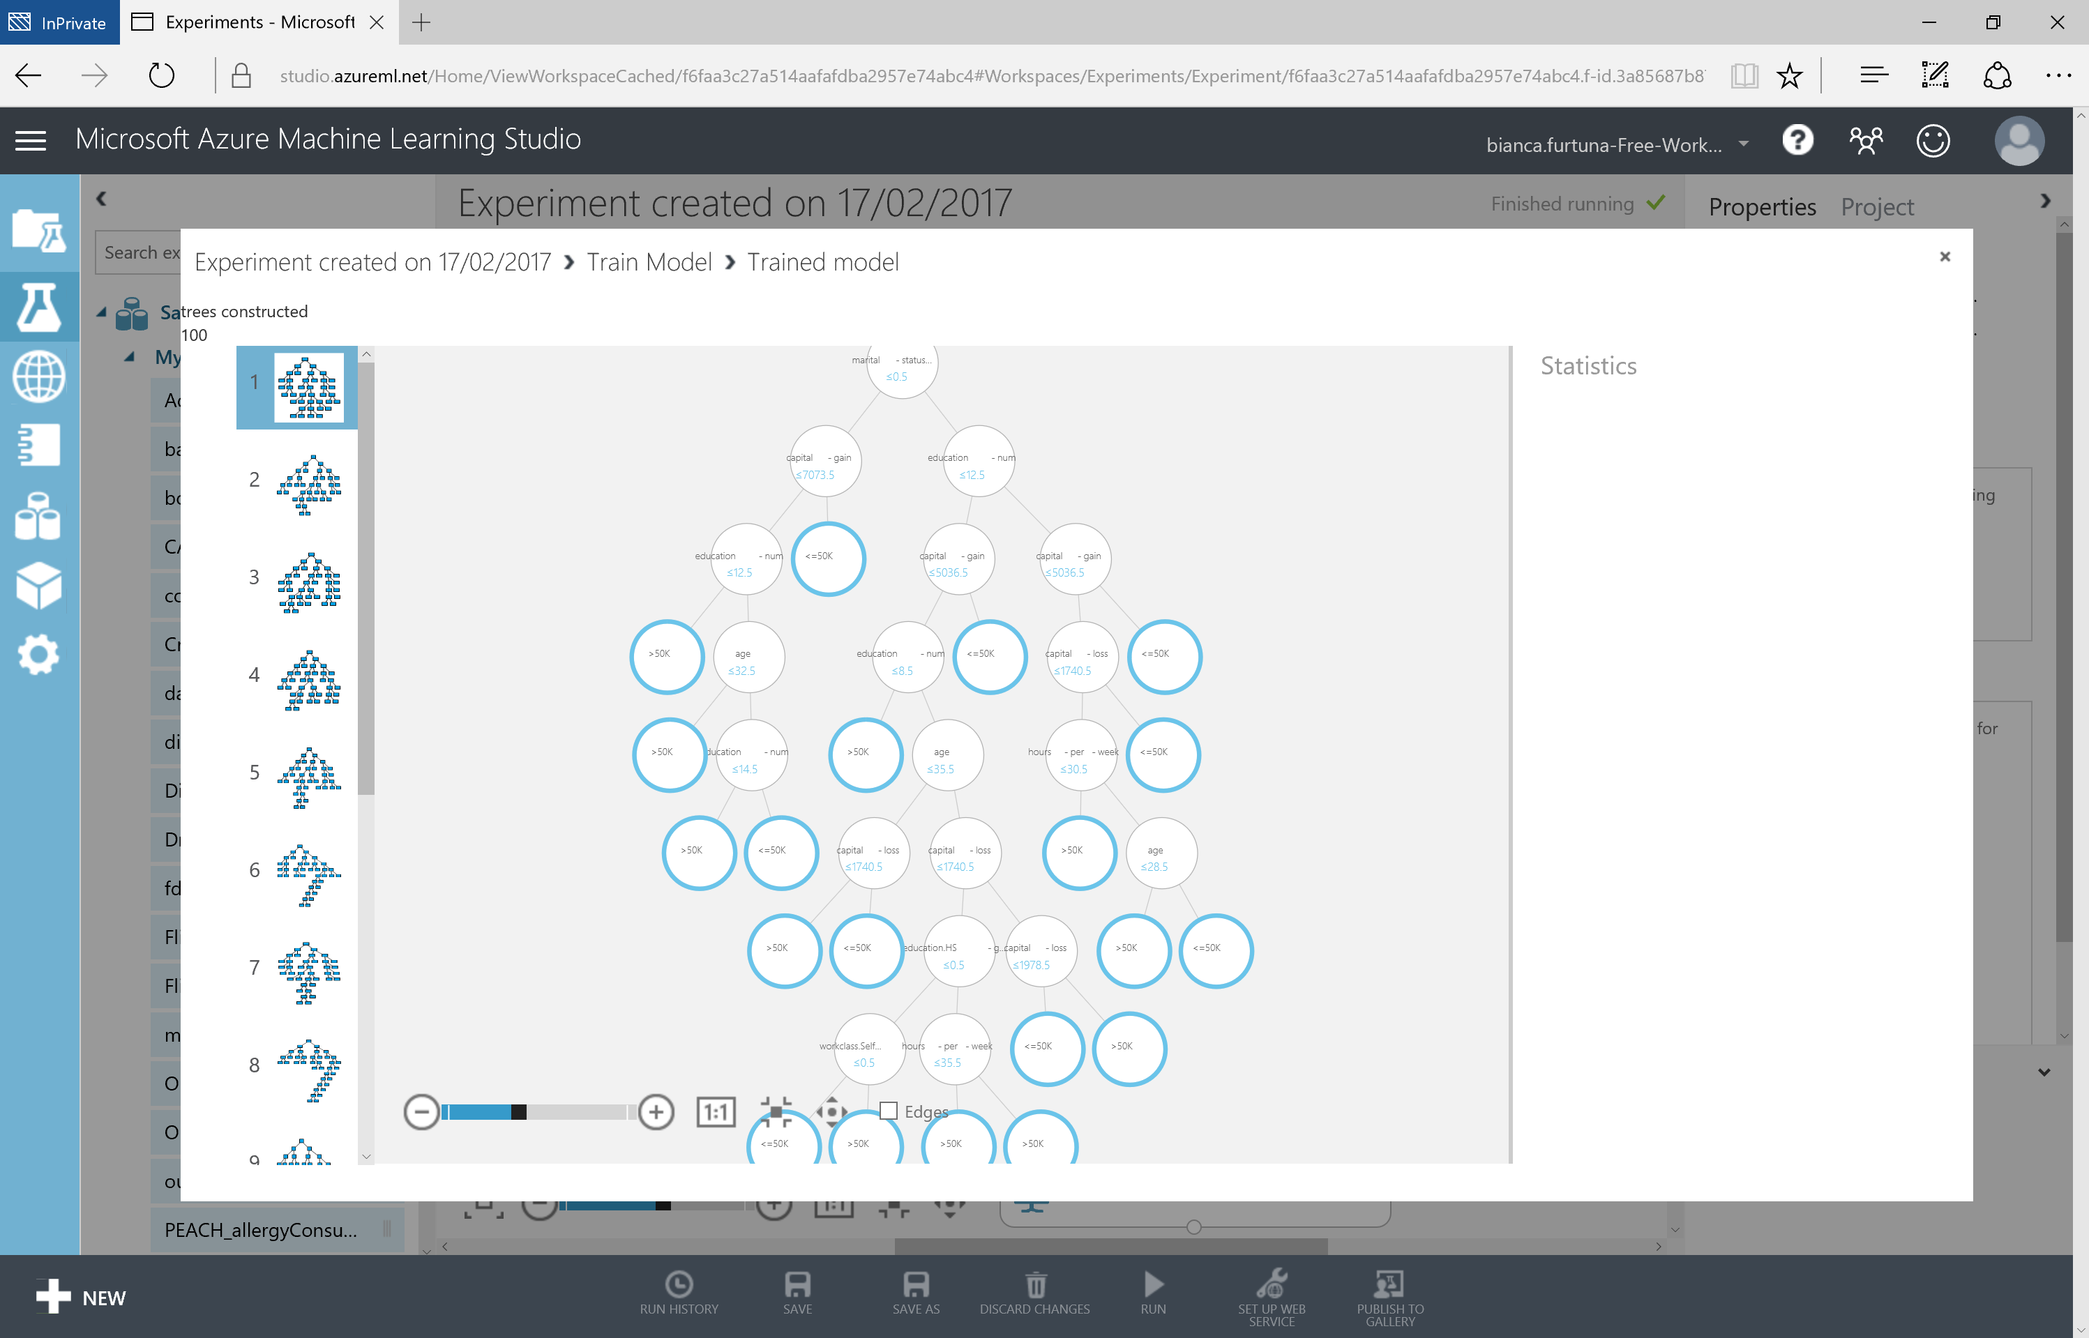

Slide 48
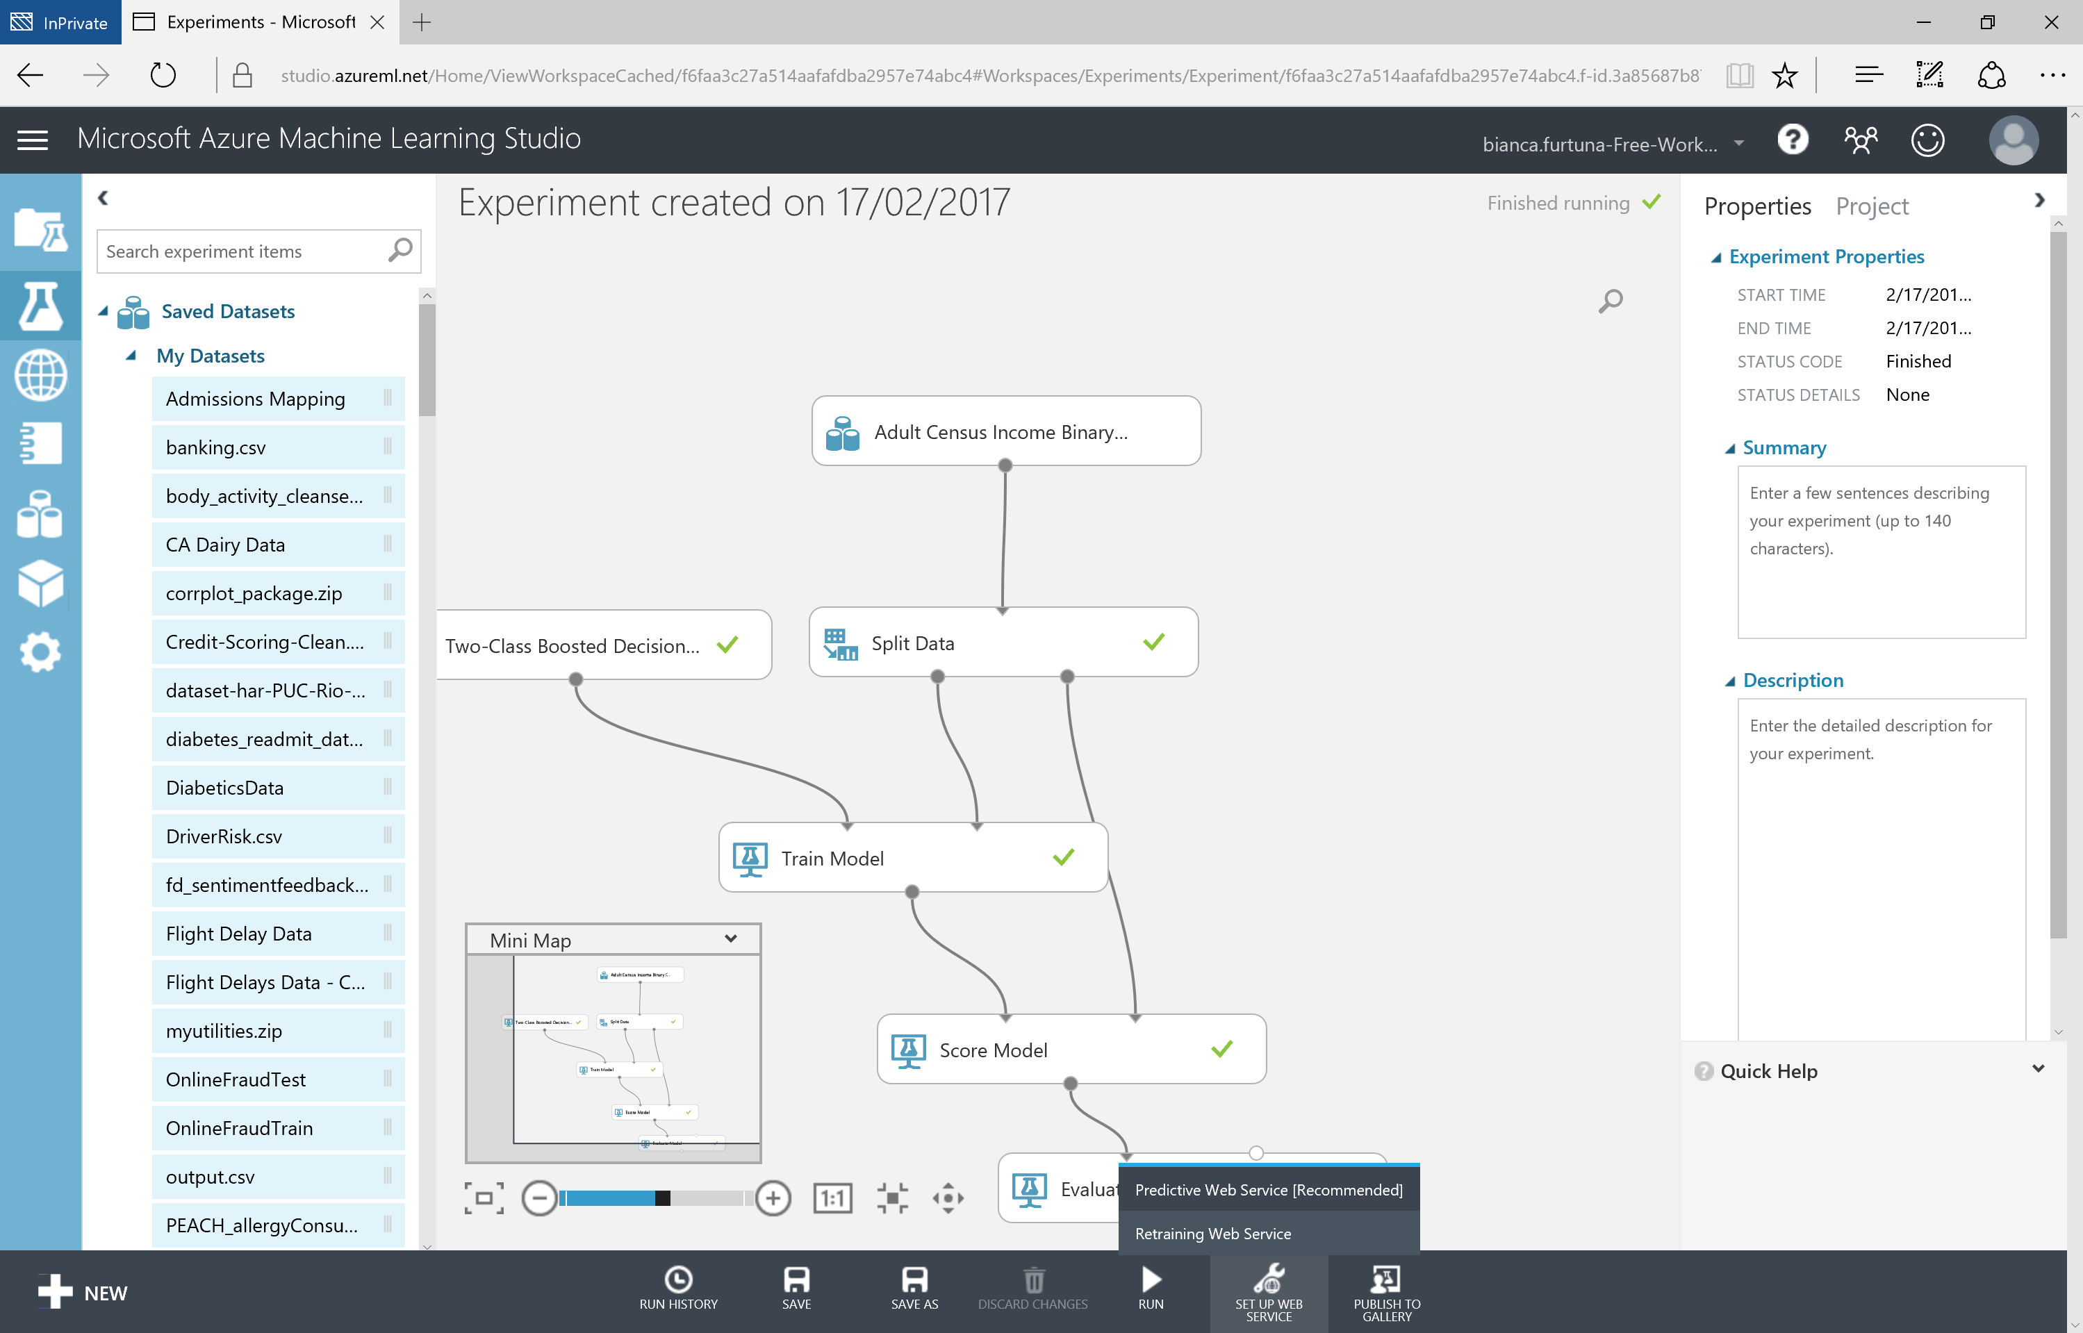

Slide 49
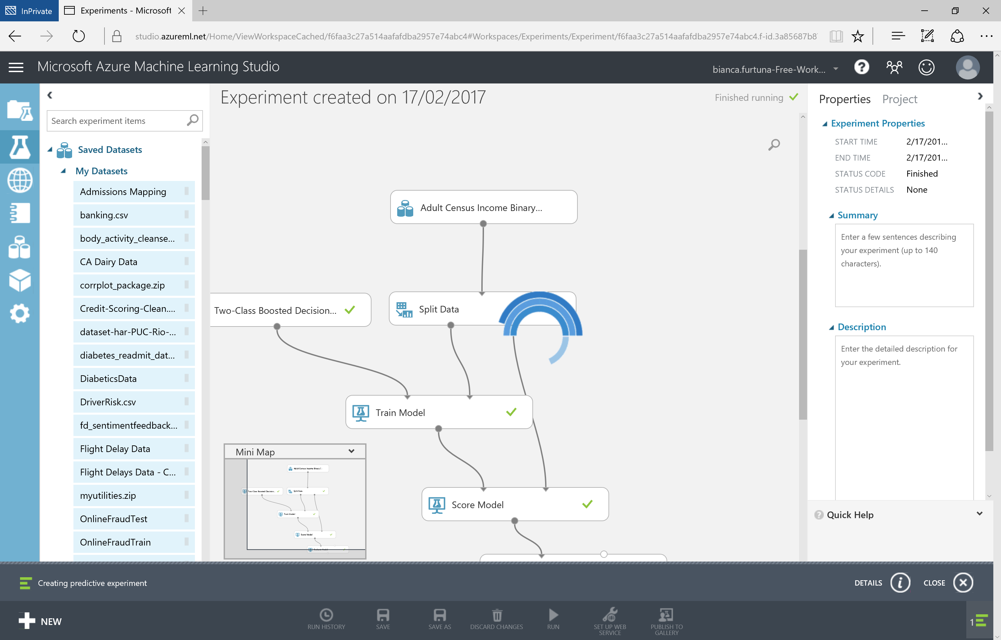

Slide 50
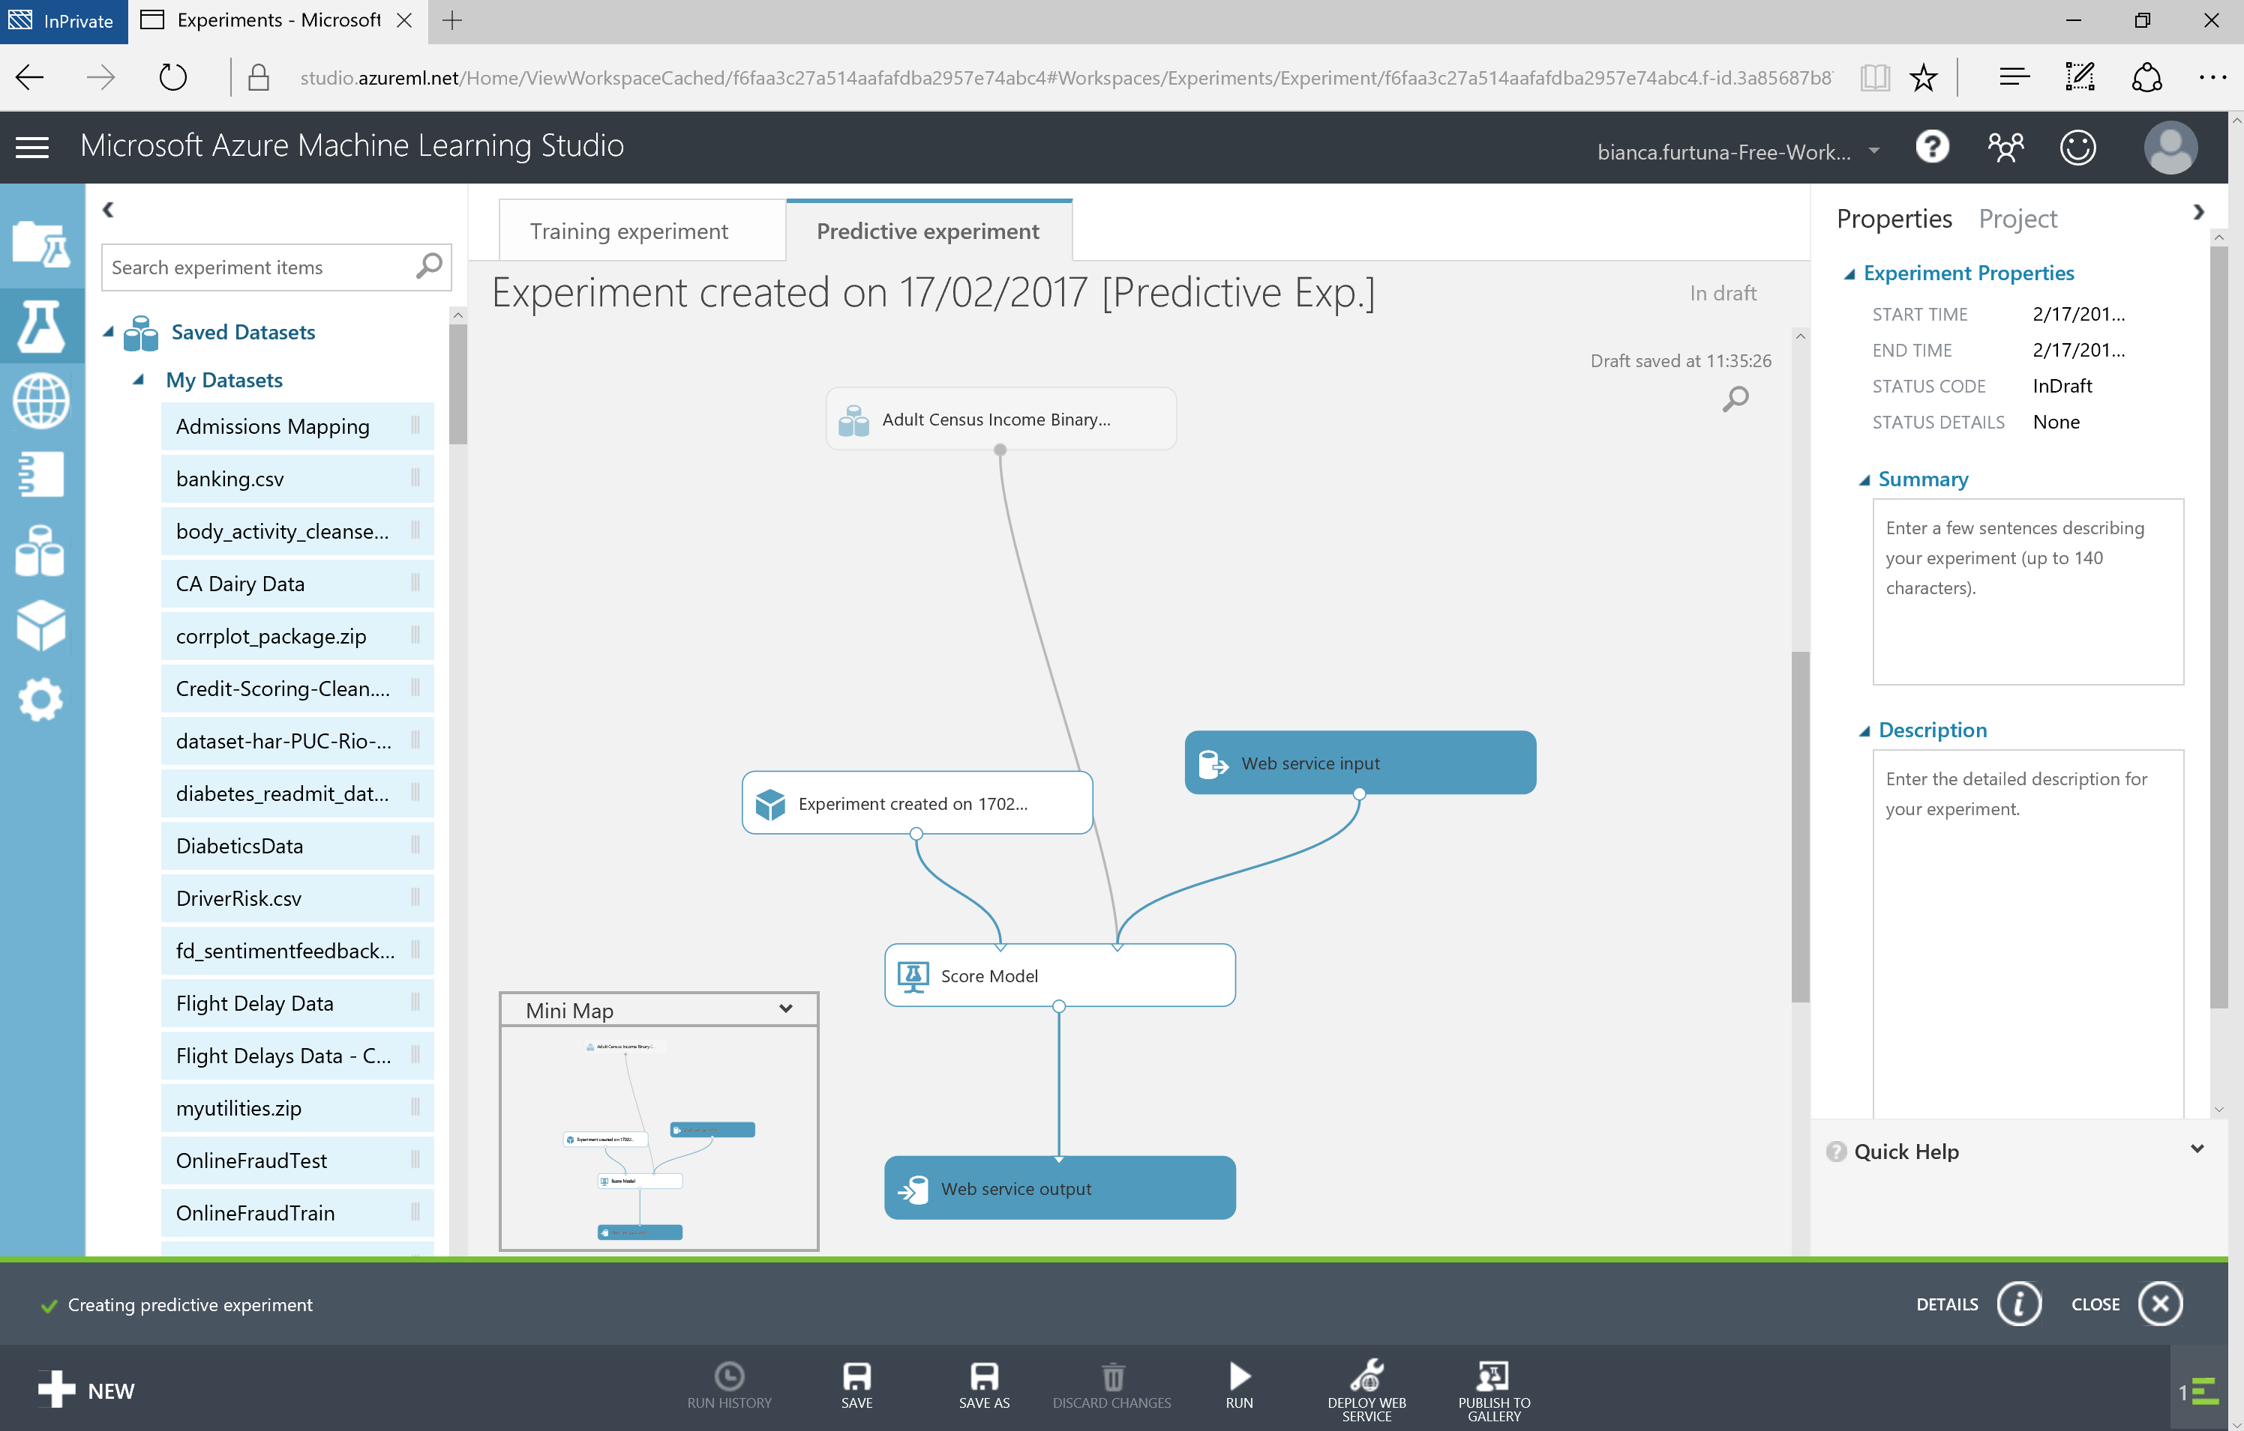

Slide 51
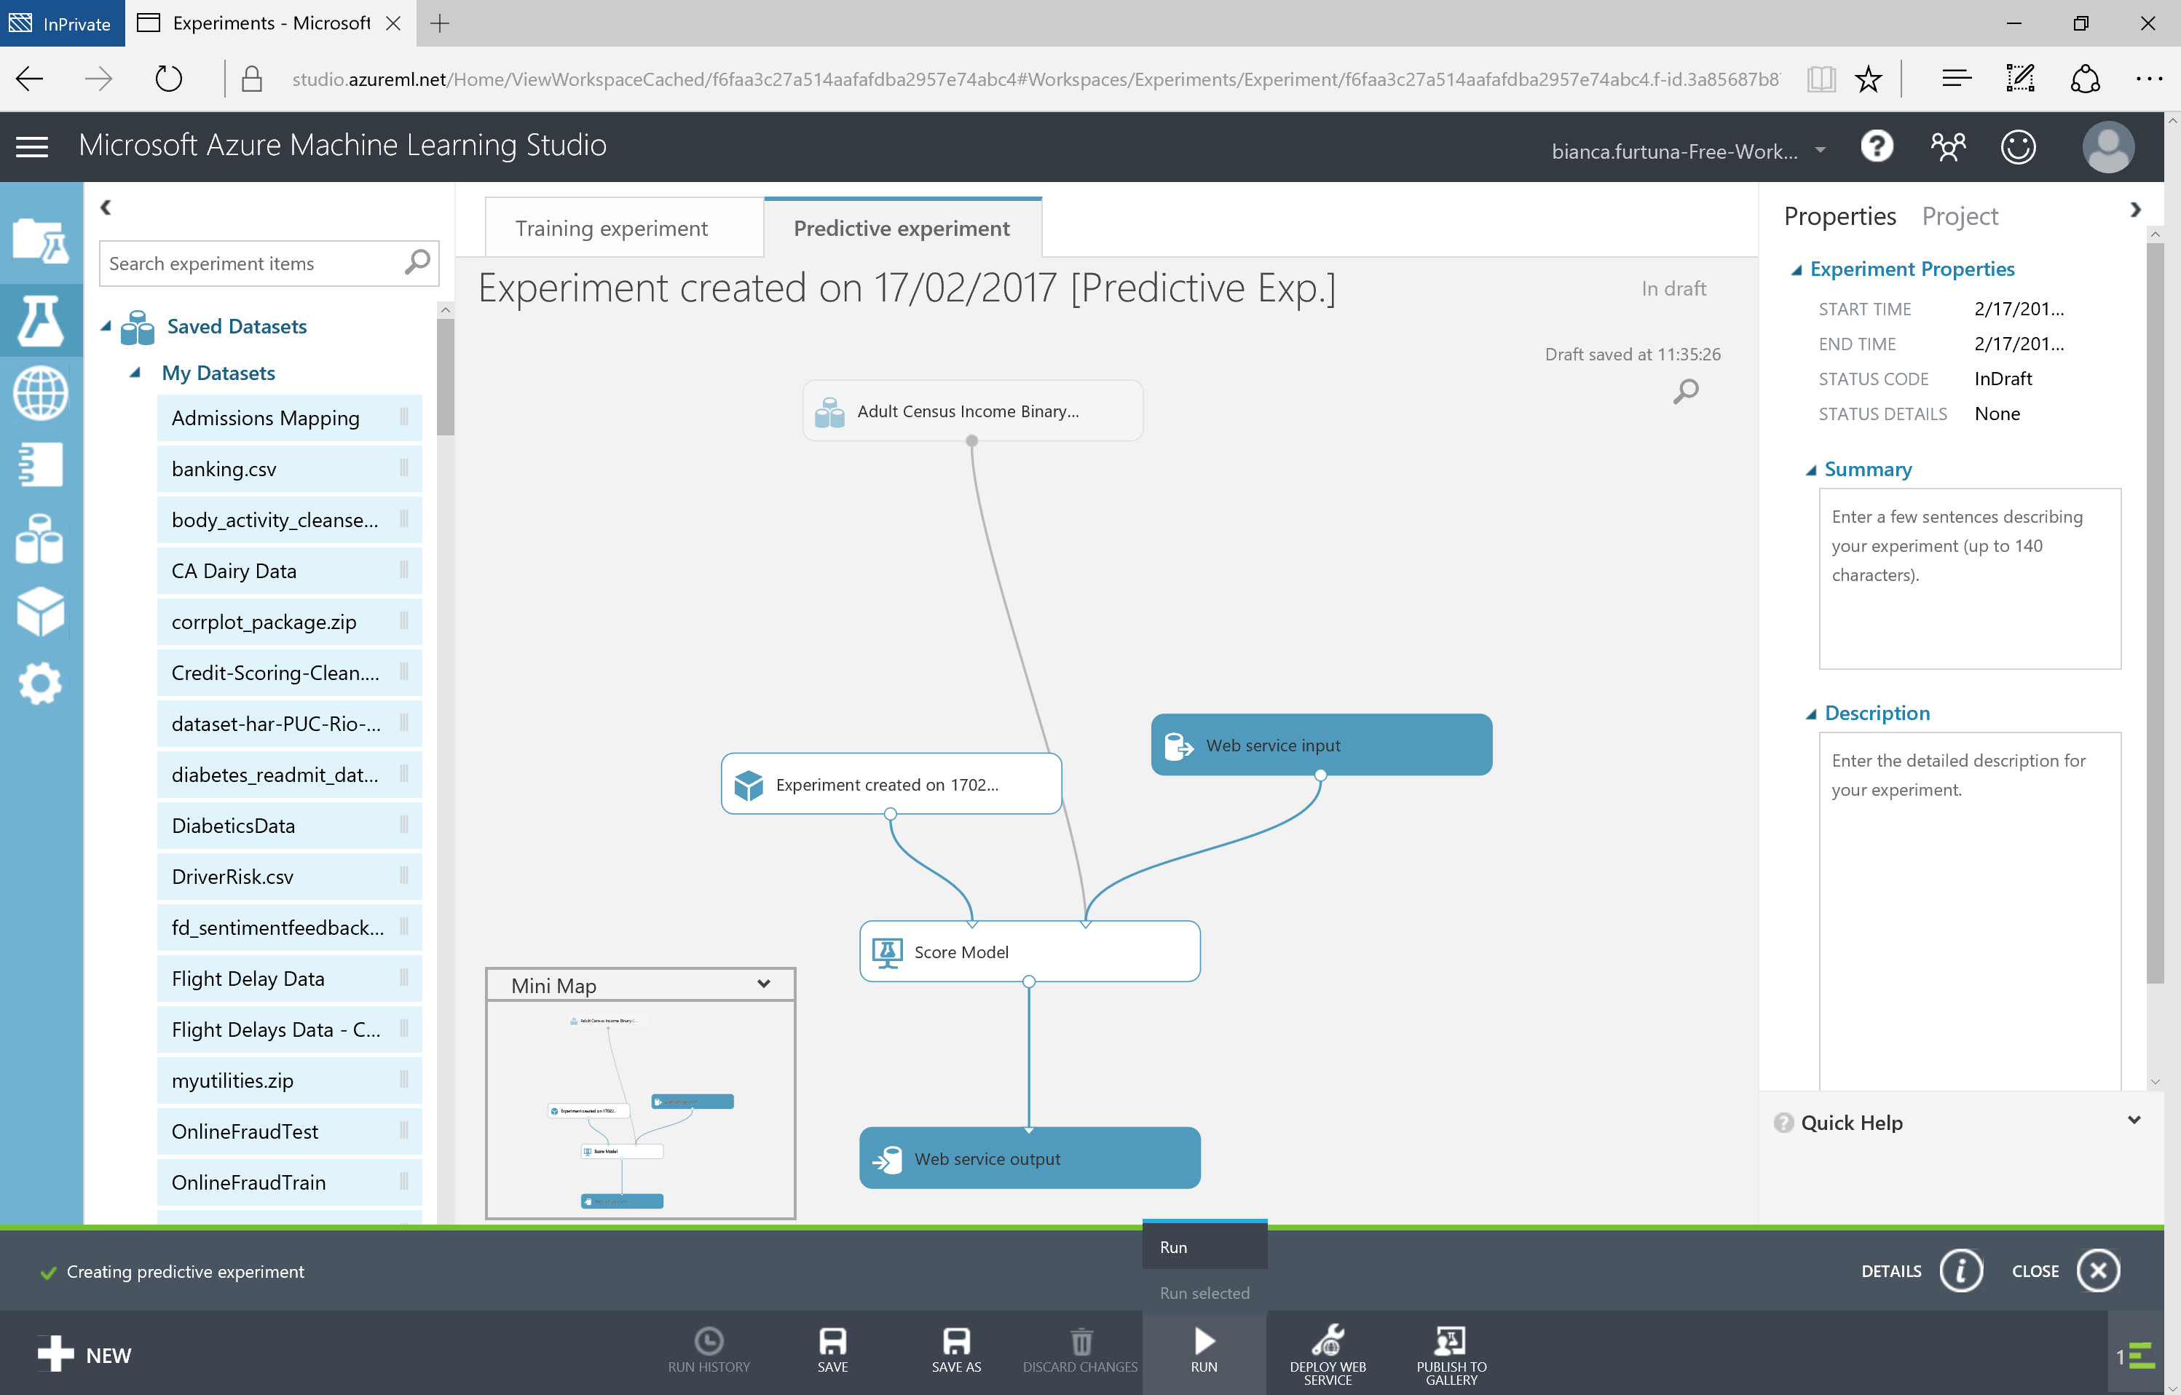

Slide 52
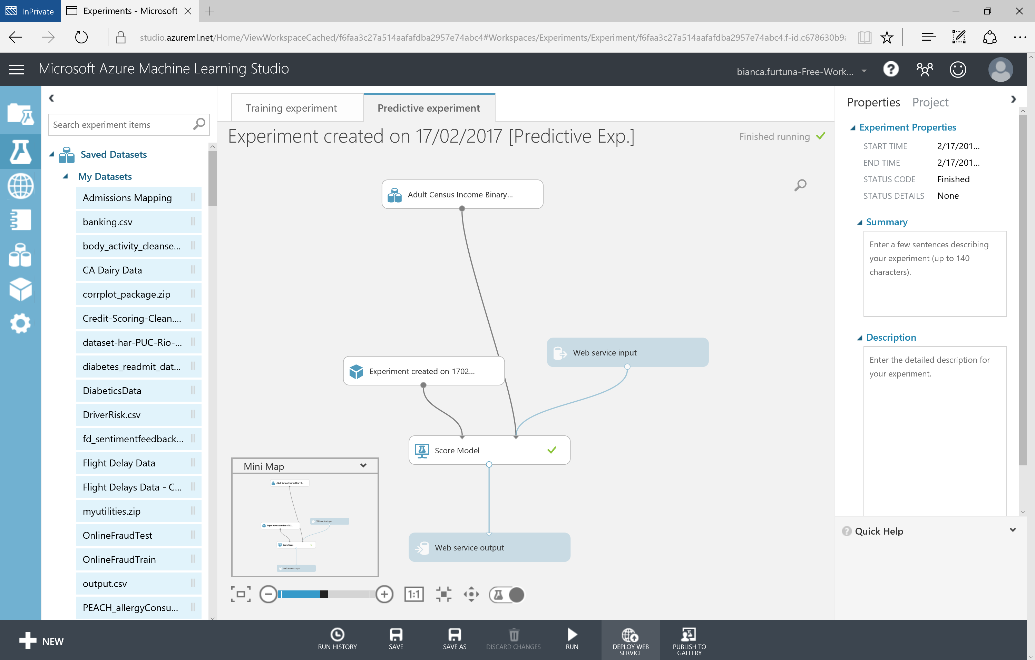

Slide 53
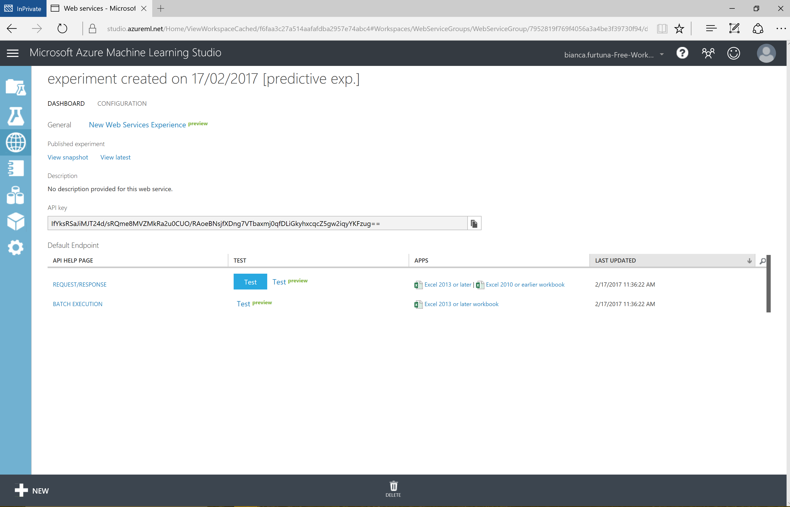

Slide 54
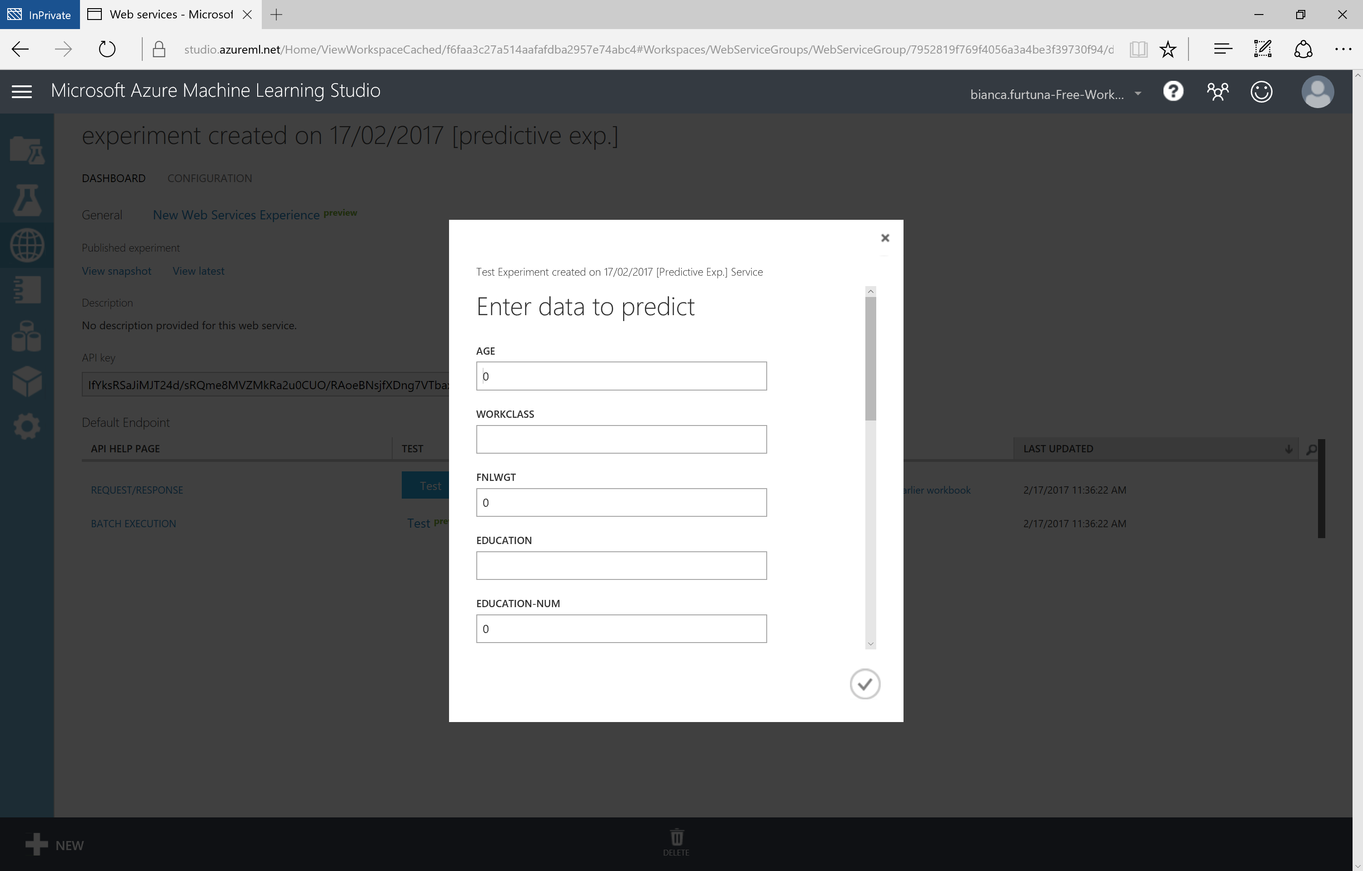

Slide 56
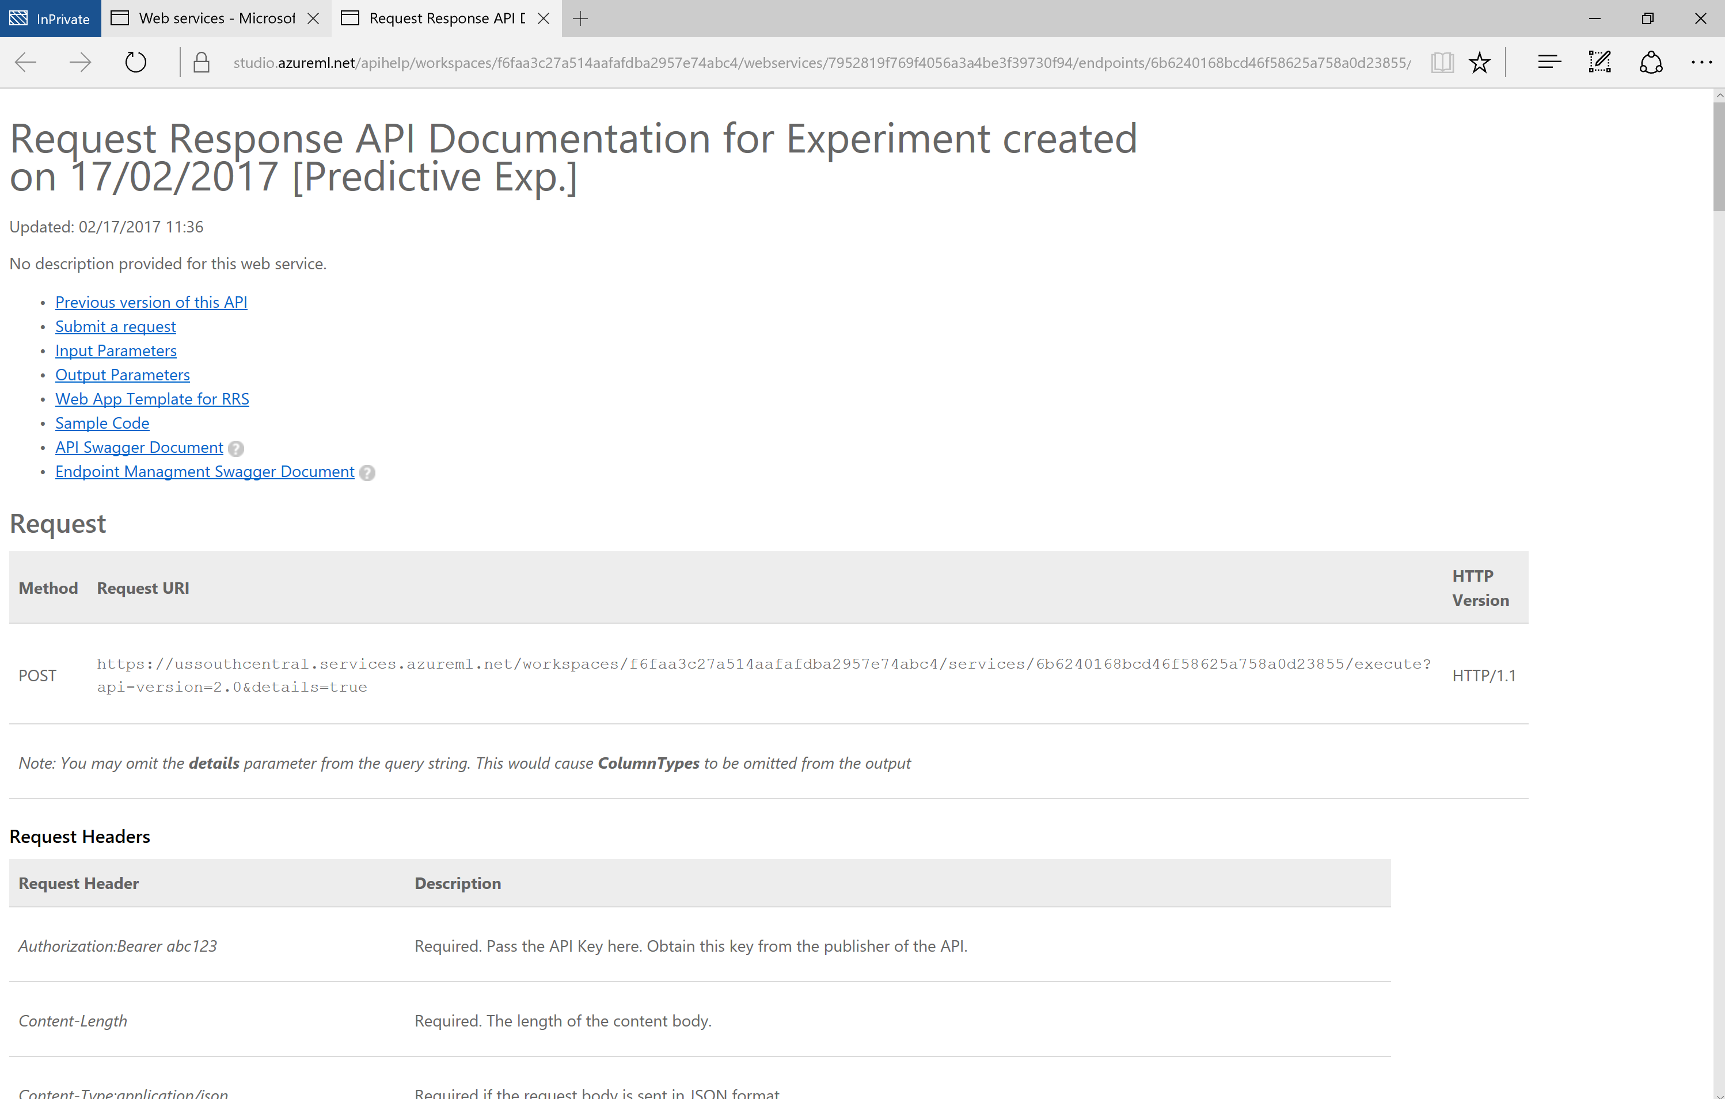

Slide 57

Microsoft Cognitive Services
Vision
From faces to feelings, allow your apps to understand images and video
Cognitive Services
Give your solutions a human side
Speech
Hear and speak to your users by filtering noise, identifying speakers, and understanding intent
Language
Process text and learn how to recognize what users want
Knowledge
Tap into rich knowledge amassed from the web, academia, or your own data
Search
Access billions of web pages, images, videos, and news with the power of Bing APIs

Slide 58
Microsoft Cognitive Services
Vision
Computer Vision | Emotion | Face | Video
Cognitive Services
Give your solutions a human side
Speech
Custom Recognition | Speaker Recognition Speech
Language
Bing Spell Check | Language Understanding Linguistic Analysis | Text Analytics | Web Language Model
Knowledge
Academic Knowledge | Entity Linking Knowledge Exploration | Recommendations
Search
Bing Auto Suggest | Bing Image Search | Bing News Search Bing Video Search | Bing Web Search

Slide 59
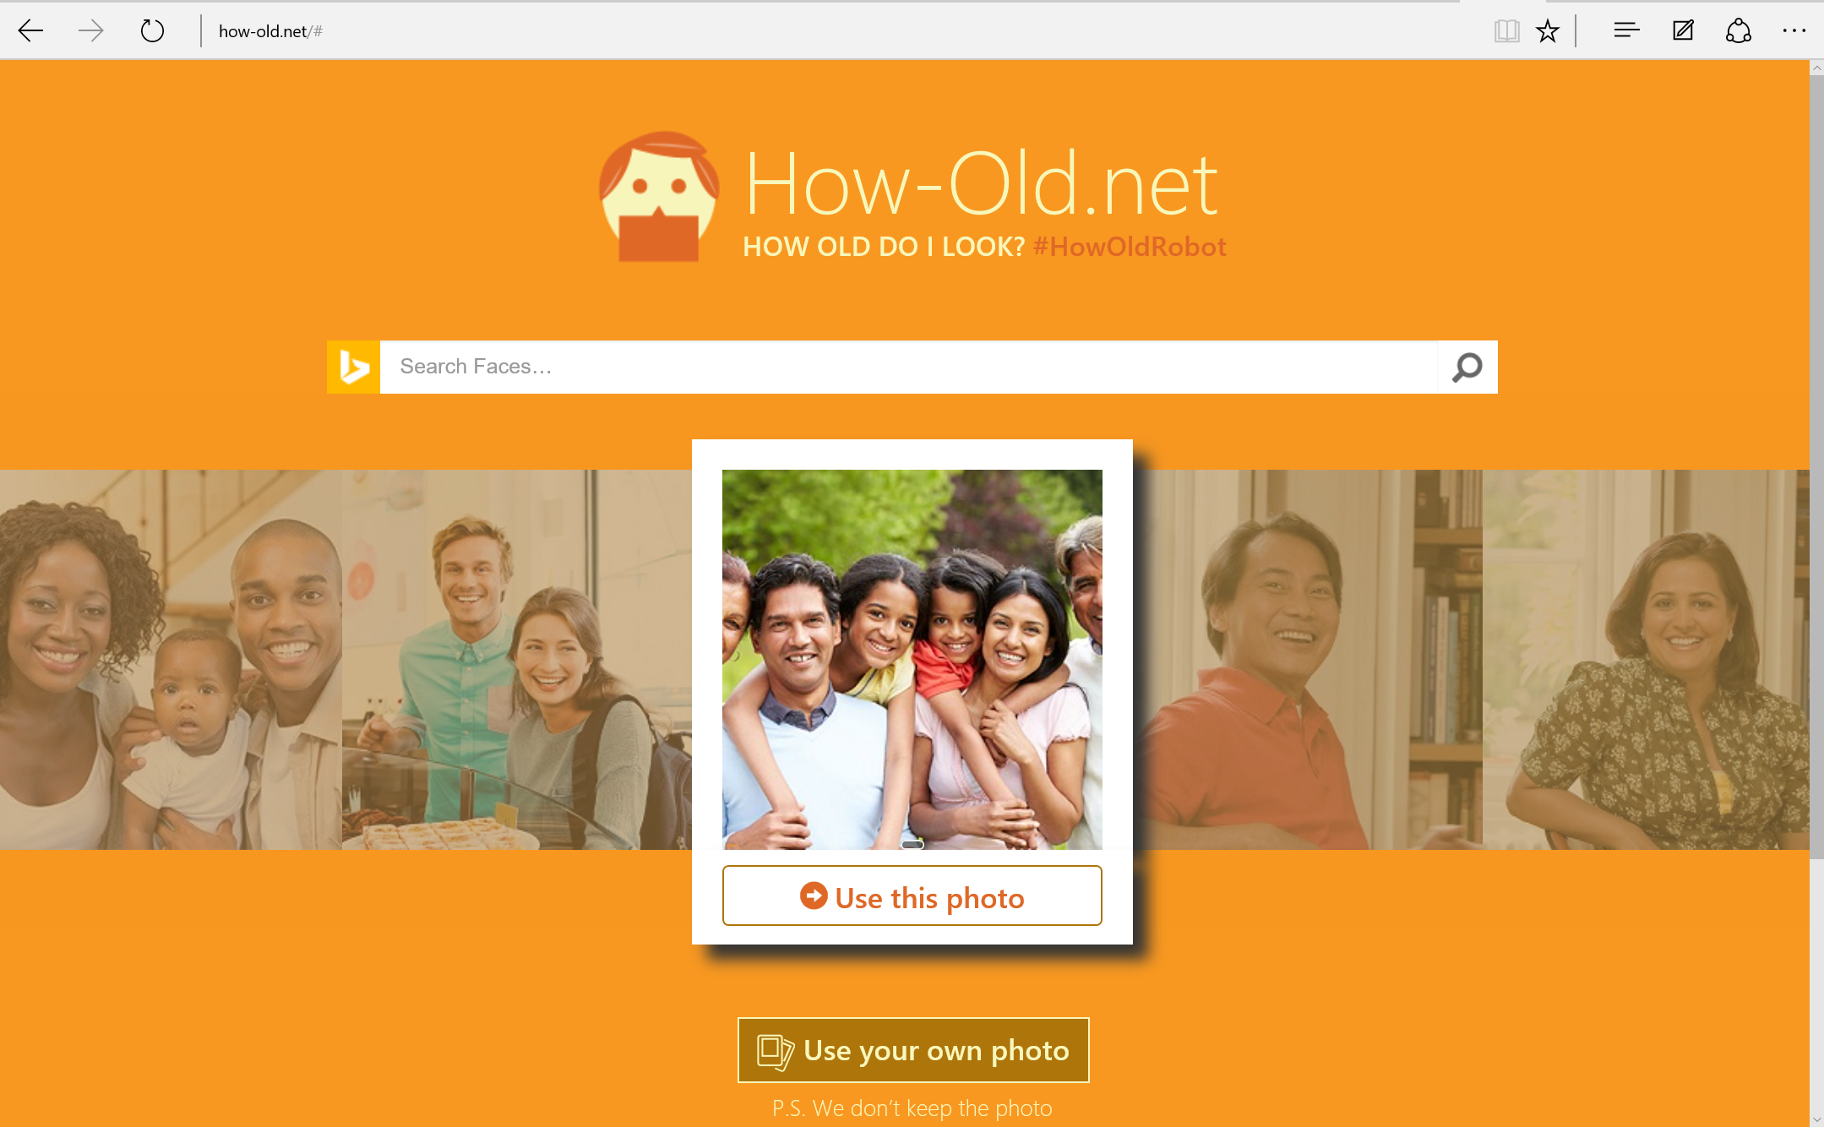

Slide 60
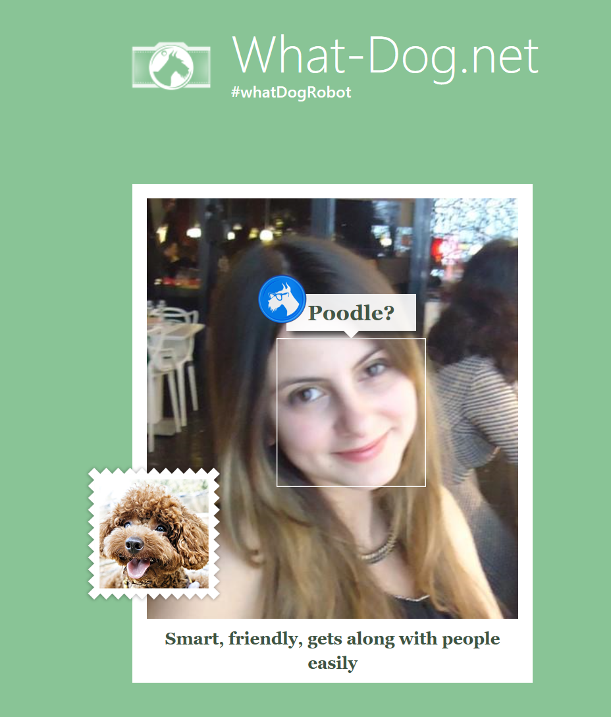

Slide 61
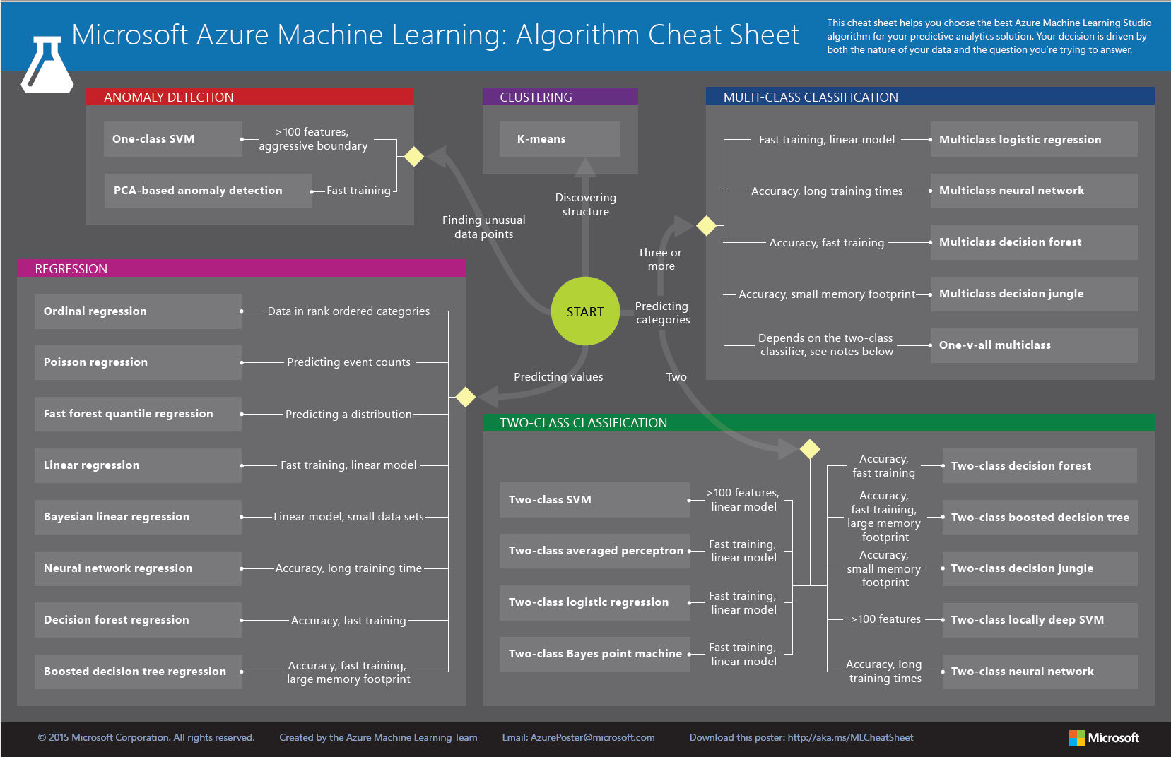

Slide 62

Thank you!
@Fur_Bi
bifurt@microsoft.com
http://furbi.azurewebsites.net/

